Slide 1
101 Ways to Use Tagxedo
Hardy Leung
www.tagxedo.com
Copyrighted. All rights reserved

Slide 2
What is this About?
Words + Image + Tagxedo = Amazing Visual Arts
Tagxedo is versatile, flexible, and fun!
Hence, 101 Ways to Use Tagxedo
Each way is unique, and illustrated with an example
I focus on unique techniques or use models
The number of variants certainly far exceed 101
Caution: Google Docs may not look right on IE6/IE7
IE8, Firefox, Safari, Opera all somewhat okay
Different browsers render HTML differently
Best viewed in Chrome
Hope this inspire you to make your own Tagxedo!
And please help me spread the word
Use this URL: http://bit.ly/101tagxedo
Hardy Leung (ksleung@tagxedo.com)

Slide 3
Tagxedo Skills
Basic
Load, save, respin (color, theme, orientation, font)
Default shapes (e.g. heart, dove)
Intermediate
Custom shapes
More respin (make selection, use lock)
History mode
Options
punctuation, numbers, common/identical Words, tightness, emphasis, word count, hard boundary, font preference, Deja Vu, skip words, normalized frequency
Tilde (~) and frequency modifiers (e.g. Love:20)
Advanced
Custom fonts, more custom shapes (with editing)

Slide 4
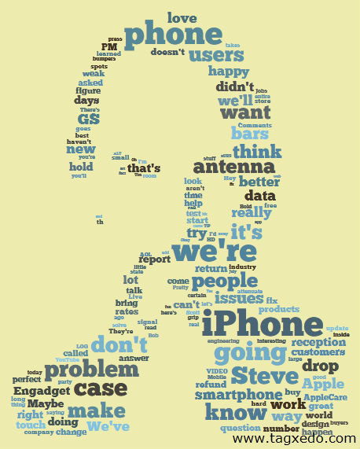
Summarize a Presentation
Steve Jobs' "We Are Not Perfect" Press Conference

Slide 5
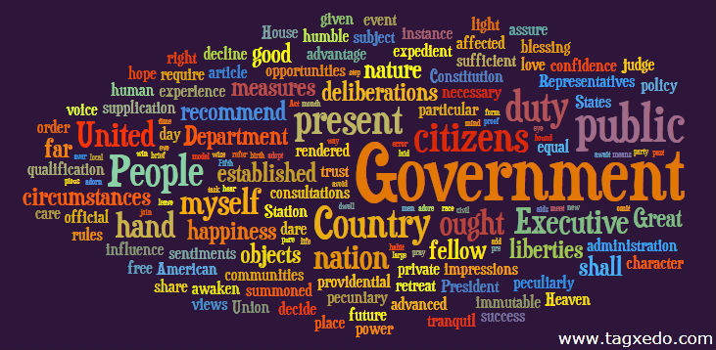
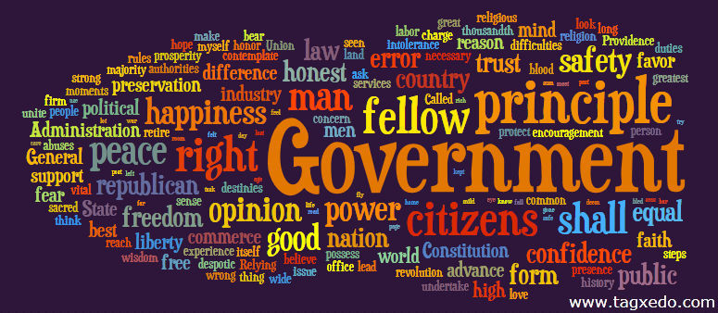
Compare Similar Documents
Use option "Deja Vu" to show identical words in the same color
George
Washington
Thomas
Jefferson

Slide 6
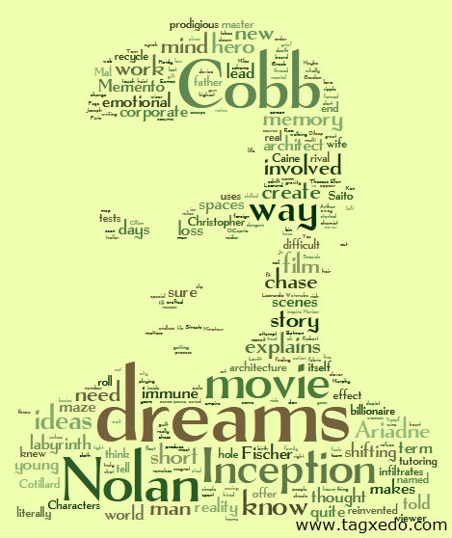
Make a Movie Review
Roger Ebert's Review of "Inception"

Slide 7
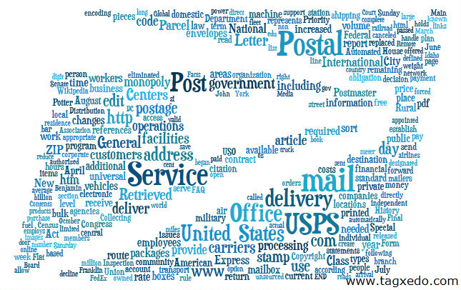
Turn a Logo into a Tagxedo

Slide 8
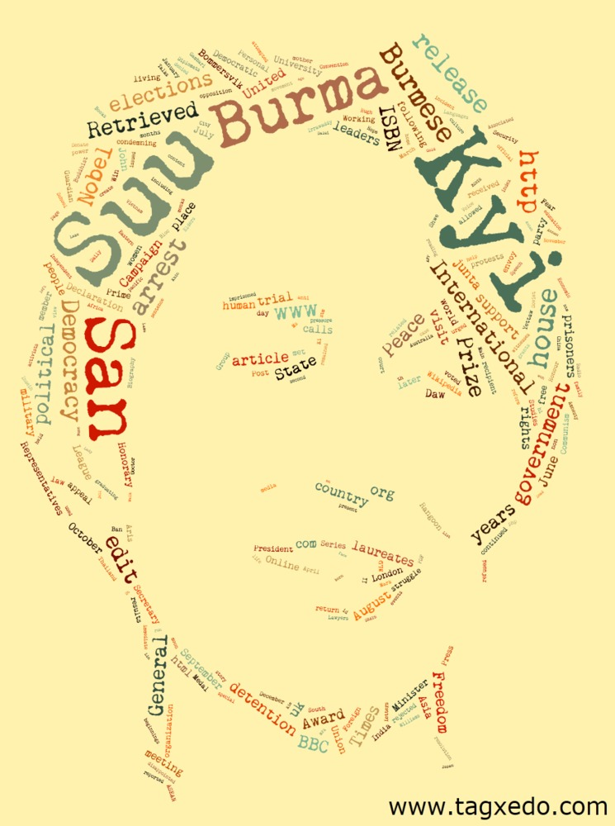
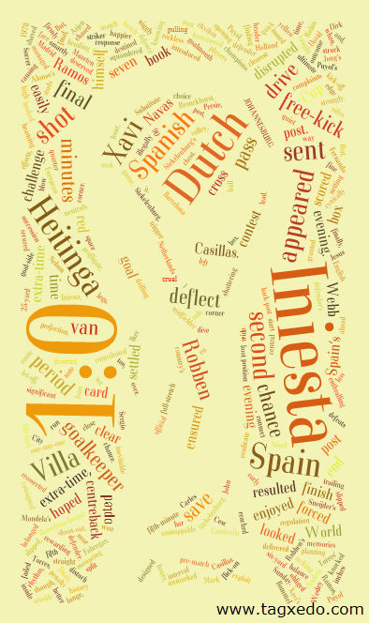
Keep Track of Current Events
Daily Tagxedo http://daily.tagxedo.com
Spain Won
World Cup
Anna Chapman, Russian Spy
Aung San Suu Kyi
in House Arrest

Slide 9
Make a Gift for your Favorite Teacher
This is the recreation of a real gift I made for my son's beloved Kindergarten teacher
Names are repeated and weighed differently

Slide 10
Show Some Teacher Appreciation
Each student contributes 10 words to describe the teachers
Write them down on the blackboard and tally the words (combine similar words)
Order the words by frequency and enter them into Tagxedo
Make a Tagxedo with the "Frequency by Ordering" method
Make a card, and sign your names

Slide 11
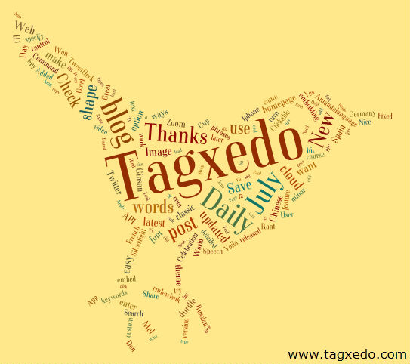
Review What You've Been Tweeting
Just enter your Twitter ID at the Tagxedo homepage http://www.tagxedo.com

Slide 12
Find out Who Follow You at Twitter
Use the Tagxedo Twitter App
http://www.tagxedo.com/fun/twitter
Biographies ("descriptions") of your followers
Up to the most recent 500 followers
Easy to share at Facebook or Tweet about it
@tagxedo's
followers

Slide 13
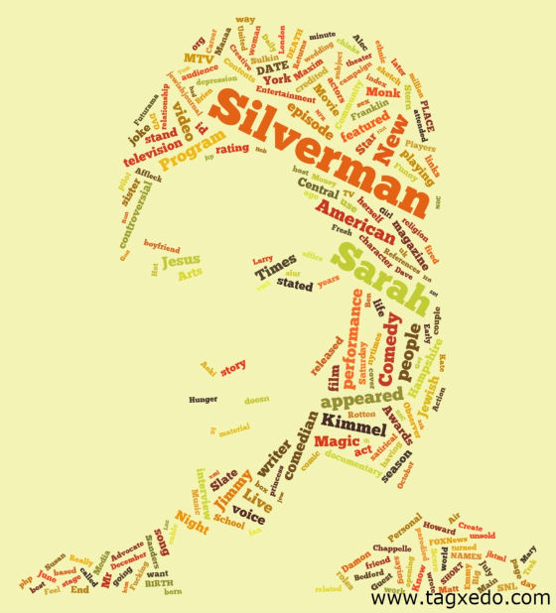
Make a Poster of Your Favorite Celebrity
For example, see Celebrity Tagxedo for celebrities like Sarah Silverman, Leonardo DiCaprio, and more
(http://celebrity.tagxedo.com)

Slide 14
Surround Yourself with Friends
Turn names of your friends into a heart-shaped Tagxedo
Facebook app apps.facebook.com/tagxedo

Slide 15
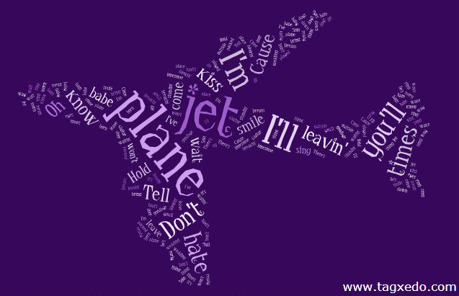
Make a Singable Tagxedo
"Leaving on a Jet Plane" by John Denver

Slide 16
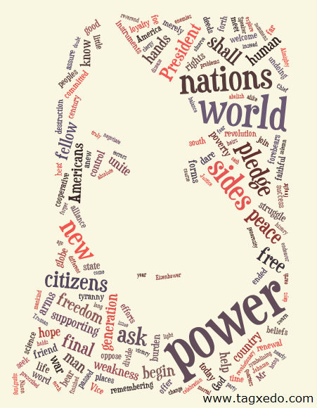
Make a Self Portrait
Use it as your avatar (Facebook, Twitter, etc)
showing just enough and not too much
Tips
Not all photos work
Need high contrast
Adjust threshold and blur
Use Capture/Undo/Redo
Prefer "Light" themes
Photos can be color or B&W
Examples of "Ideal Photos"
Steve Jobs' B&W
Abraham Lincoln

Slide 17
Say Thanks with Tagxedo
Great for note, sign, frame
Tips
Use "Normalize Frequency" for a smooth distribution
Customize it with the person's name
Highlight "Thank You" with a different color
http://www.omniglot.com/language/phrases/thankyou.htm

Slide 18
Critique Your Resume
See from a different perspective
Get instant feedback on
Use of keywords
Tone + Focus
e.g. what I did vs. how it impacted the company vs. what skills I process
A simple "scanbot" test
Good approximation of what recruiters will see
If you are not impressed by the top words, neither will your recruiters

Slide 19
Make a Graduation Card
Use words of encouragement
Customize
Name of student
Name of school
Theme of school
"Class of 20xx"
Use graduation-related shapes
cap and gown, school logo, ...

Slide 20
Stylize Your PowerPoint Presentations
Use Tagxedo effectively to separate out different sections of a long presentation
Use text from the presentation
Use a low-constrast custom theme as the backdrop ('Low' ffffff aaaaaa)
Normalize frequency
Suppose the section is about Photography, add this to the text
Photography:#ff0000:@0:1000
(red, horizontal, freq = 1000)
Make one Tagxedo for each section
Only need to change one line and then hit respin!

Slide 21
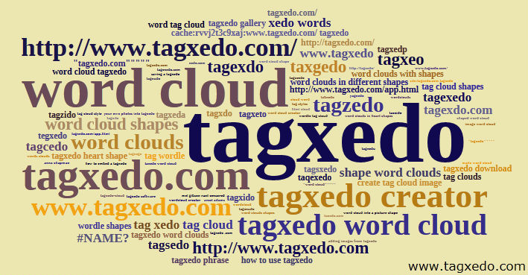
Analyze Search Keywords (SEO)
Take your Google Analytics search keywords, and massage the data to the form <word>::frequency
Options
Combine Related Words = No, Allow Numbers = Yes, Allow Punctuations = Yes, Frequency Modifier = ::
Normalize frequency, Classic Cloud
Learn from it, and optimize your site
Example: Google Analytics on Tagxedo
* word cloud > tag cloud
* Tagxedo hard to spell?
remember: starts with Tag, rthymes with Tuxedo

Slide 22
Show Some Love
Make your own unique expression of love

Slide 23
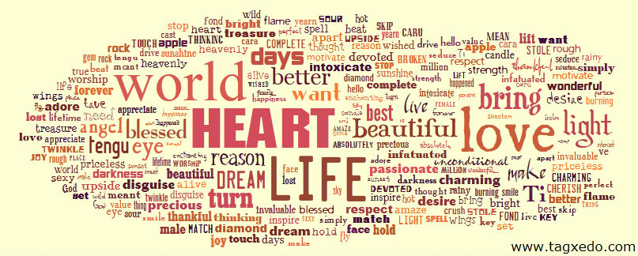
Say I Love You in 101 Ways
http://www.romancestuck.com/i-love-you-100-ways.htm

Slide 24
Make a Thank You Card
Use names of people who came to your party, shower, or seminar
Need to be careful with options
Don't Combine Identical Words
Allow Punctuations
Use Tilde (e.g. "Hardy~L.")
Optionally highlight words
Use all fonts to reflect diversity

Slide 25
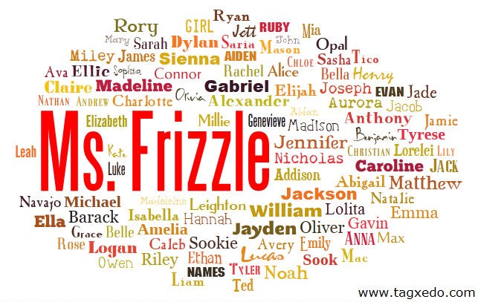
Make a Class Tagxedo
Make an artwork representing the class
Teacher first makes a sample Tagxedo
careful about students with the same name
Teacher's name (or class name) in higher frequency
Decides on the background color
Each student can now decide his/her own font and color
One time decision, so choose wisely
Teacher takes the input and respins "all" 10 times
Class votes for the best Tagxedo
Learning
Express himself/herself
Appreciate typography
Show unity

Slide 26
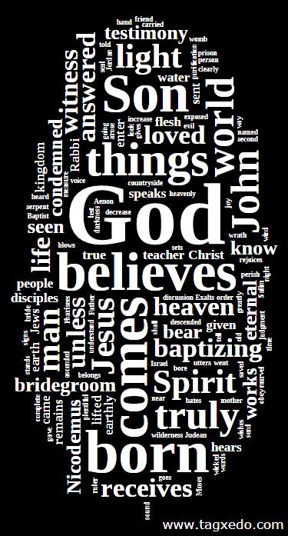
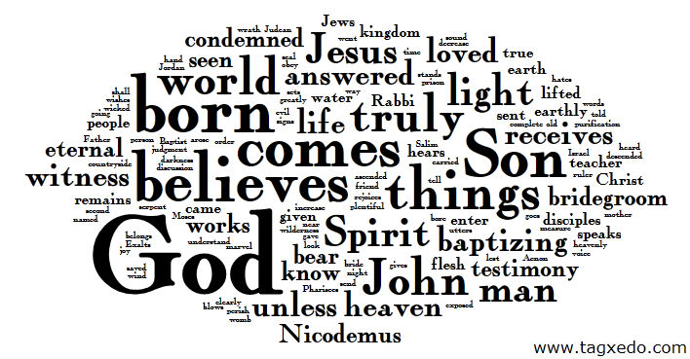
Summarize a Sermon with Tagxedo
Summarize a sermon, a scripture, or the entire bible
Or any religious or inspirational readings
B/W and W/B both work great
Already rich in beautiful words
Great for framing

Slide 27
Make a Banner Logo for your Blog
Make a Tagxedo from text of your blog as banner
To force a certain aspect ratio, use custom image
Use "Normalize Frequency" for a smooth distribution
Optionally highlight the name of your site (different color and font)
Bonus
Change background color (Layout Options) to match that of your blog

Slide 28
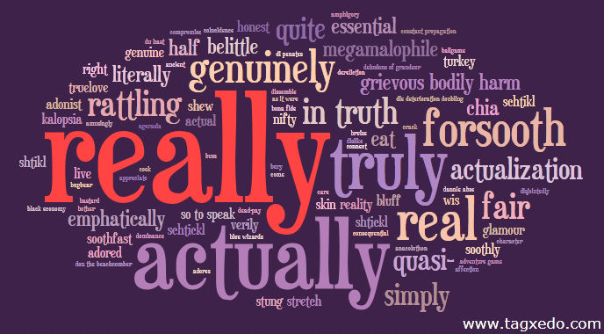
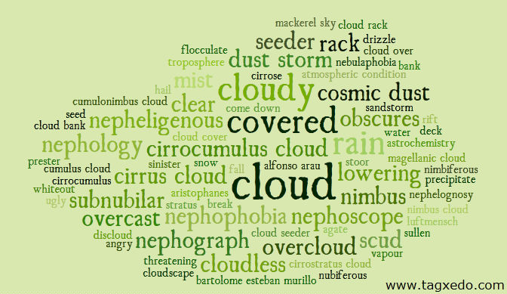
Expand Your Vocabulary
Take a concept and use reverse dictionary to find related concepts
http://www.onelook.com/reverse-dictionary.shtml
Sorted list of related phrases
Normalize frequency
Custom color to reveal the original word
Find words outside your language comfort zone
Learn related concepts
Expand and improve your vocabulary

Slide 29
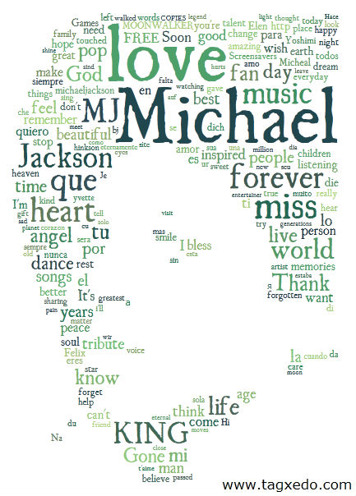
Pay Tribute
Pay tribute with words and images
Fans' tribute to Michael Jackson

Slide 30
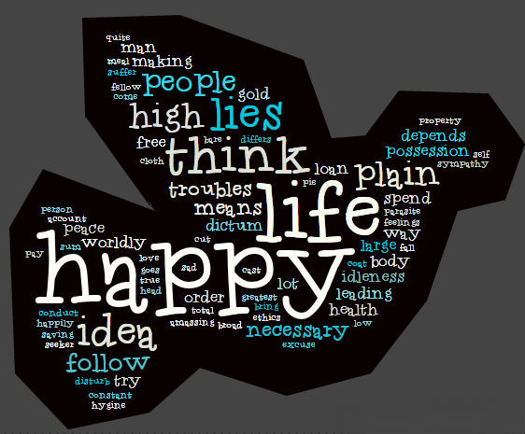
Turn Your Own Handwriting into Artworks
Create your own handwriting font
Add the custom font to Tagxedo
Easy to tell if a font is good or bad in Tagxedo
Use it to create artwork for use in scrapbook, poster, tag
e.g. your writing + shape + font + cutout = scrapbook art

Slide 31
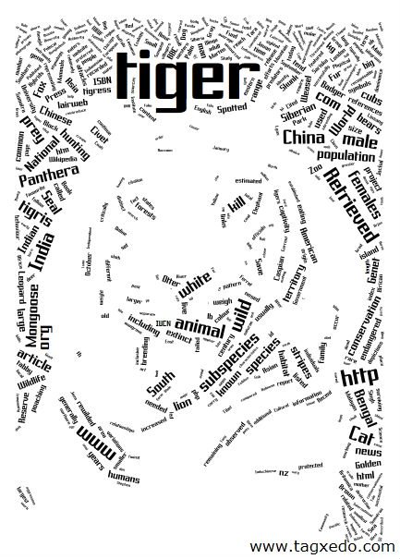
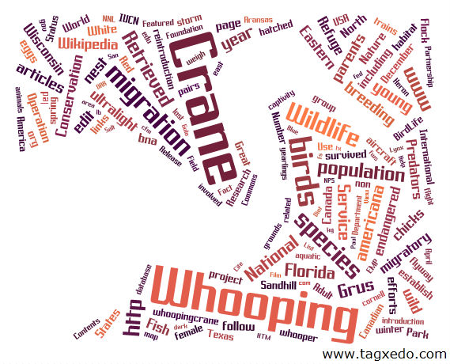
Decorate With Tagxedo
Make posters or picture frames of your most impressive Tagxedo artworks for decoration
Home, kids' rooms, or classroom, lobby, hallway
Also works great for conference rooms with themed names (e.g. named after countries, animals, pop singers)
Attractive and elegant

Slide 32
Advertise a Product
Make an ad using Tagxedo
Eye catching, refreshing
Example of a Fish Oil Supplement Ad
Touting benefits of fish oil
Use words describing the benefits, and shape of a fish
Normalized frequencies
Many customization possibilities

Slide 33
Break the Ice
At the beginning of the school year, ask each student to make a Tagxedo about himself/herself
Show a sample (e.g. one about you, or previous class)
What you like, what's unique about you
Normalize Frequency make the exercise much easier (just give an ordered list of words or phrases)
classic cloud: >40 words/phrases shape: >100
Each student gets a few minutes to talk about themselves
Easiest - each makes a list, teacher makes Tagxedoes
Hardest - each makes own Tagxedo (with shape)

Slide 34
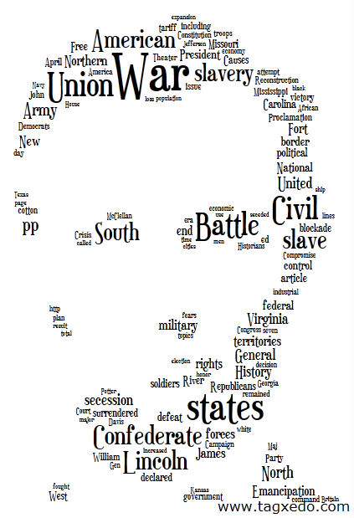
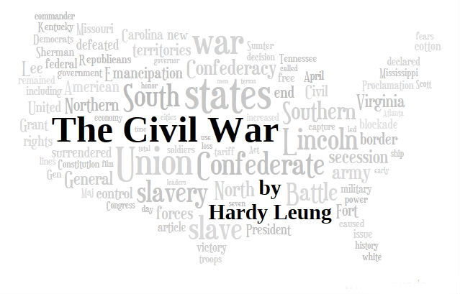
Make a Cover
Make a book, essay, or notebook cover
Easy
Choose a shape that best represents the project
Use text from the project
Advanced
Embed the title of the book/essay/project into the Tagxedo and show it in a different color/font/size

Slide 35
Decorate Marketing Pamphlets/Datasheets
Complement your product datasheets or marketing materials with a Tagxedo
Summarize the products or message
Birds-eye view, captivating
Customers get a gist in one glance

Slide 36
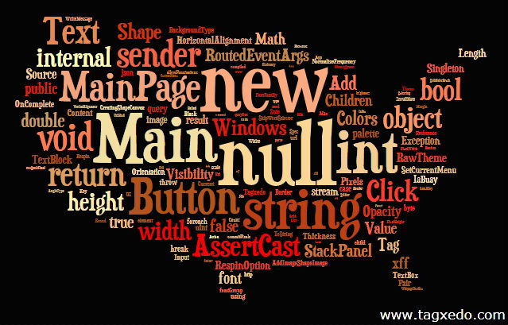
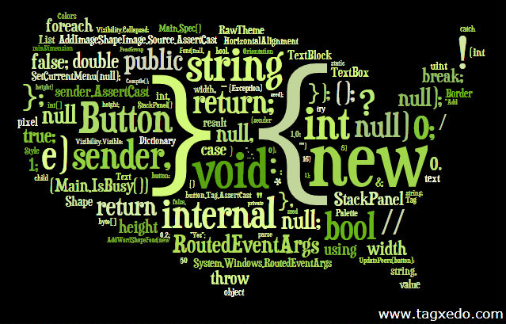
Make an Art Out of Any Text
Literally any text can be turned into something interesting
source code
movie script
Even non-text (actually quite interesting!)
Pdf, Dll, Doc
Example shown
Source code of Tagxedo visualized in Tagxedo
Top: Words only
Bottom: numbers and punctuations

Slide 37
Show Your Customer Testimony
Show how much your customers love you with a Tagxedo
The example was based on actual testimony from 11 customers (text used as-is) of a wedding cake shop
Heart shape, logo, custom cloud all work well
Hand fonts or light-hearted fonts

Slide 38
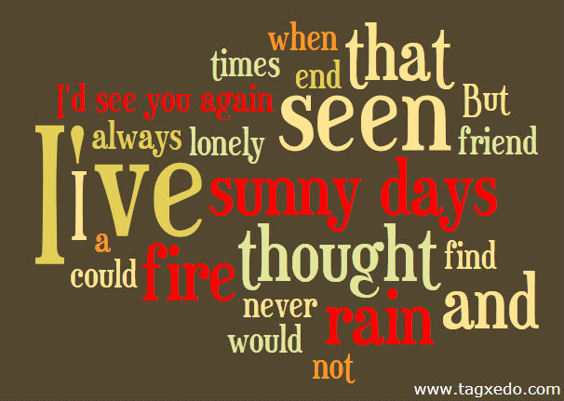
Make a Beautiful Sentence
Even a single sentence can make a beautiful Tagxedo
Tips
Classic cloud (since few words in a sentence)
Normalize frequency
Pay attention to punctuation (e.g. I've)
Selective highlighting of choice words
Quotable quotes, excerpts of lyrics, and memes of the day

Slide 39
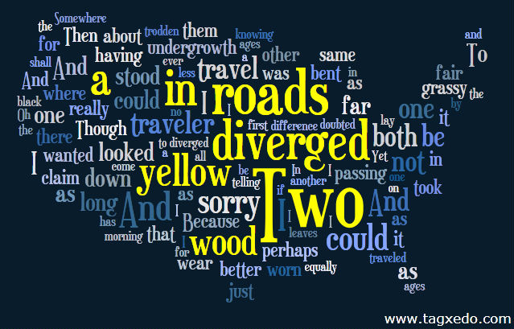
Make a Poem Tagxedo
Take your favorite poem and make an inspiring Tagxedo
Copy the entire text of the poem
Do not combine related or identical words, and do not remove common words
So that the entire text appears as is
Normalize frequency
Color the first line of text differently
The Road Not Taken
I Do Not Love You Except ...

Slide 40
Savor Your Memory
Make a Tagxedo out of your memory of the good o' days
Memorial things that you did
Favorite places to be with friends
People you loved and people who changed you
For younger folks
Capture the best days with your friends
Share the memory
Say how you feel
Wonderful gift to friends

Slide 41
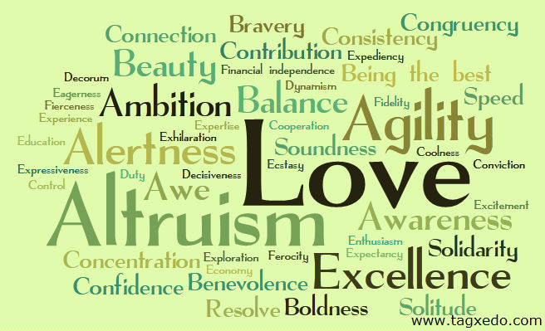
Discover Your Personality
Make a list of 100 values or personality traits
Each person give a score for each value (0-100)
Love:100 Coolness:50 Control:20 Flexibility:70
Feed the data to Tagxedo
Use the "Deja Vu" option, show maximum 50 words
Normalize Frequency - forcing a ranking
Make Tagxedoes and compare
Find similarity, differences among people
Games for bridal shower, couple dates, self introspection, ice breaker

Slide 42
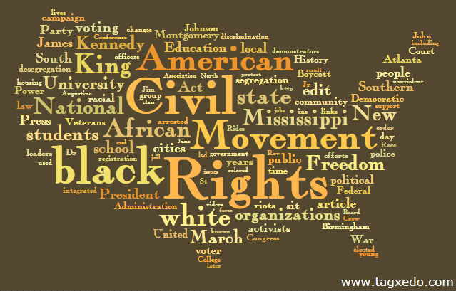
Start a Class Topic
Start a class topic with Tagxedo
Civil right, cold war, jazz, world cup, Lady Gaga ...
Use Wikipedia (http://en.wikipedia.org/wiki/<topic>)
Use preset font/theme/orientation and options
Can be interactive (e.g. class is interested in Malcolm X, so let's make one right then and there)
Talk the Tagxedo, and write down keywords for more detailed discussion

Slide 43
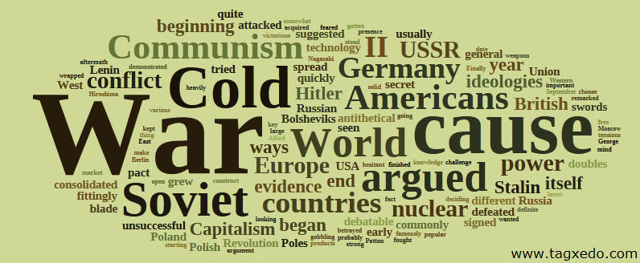
Improve Students' Writing Skill
Adapted from a Wordle suggestion made by Russeltarr
Turn a student's history essay into a Tagxedo
Use "Customize Words" to take out common English words
See if the class can figure out (a) the topic, and (b) the title
If they fail to do so, it means the essay lacks sufficient focus on the question
Use "Normalize Frequency" if distribution is out of whack

Slide 44
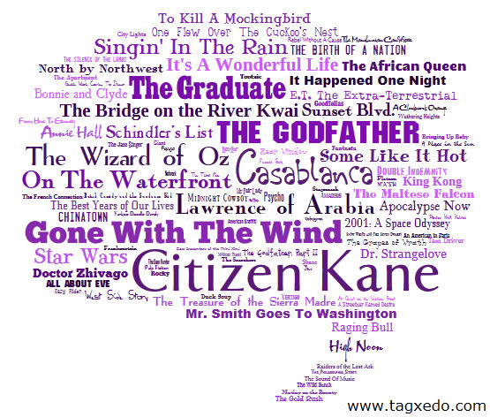
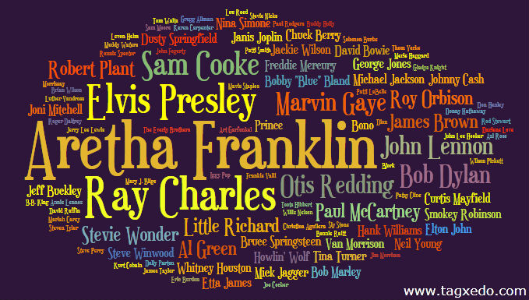
Convert any "Top 100" to a Cloud View
Rank the list from top to bottom + Normalize Frequency
50-100 seems to work well, 25-50 may also work
Classic cloud is more appropriate for smaller number
Change tightness and/or "Spread" to adjust dramatization
Rolling Stone Top 100 Vocalists
100 Top Movies of All Time

Slide 45
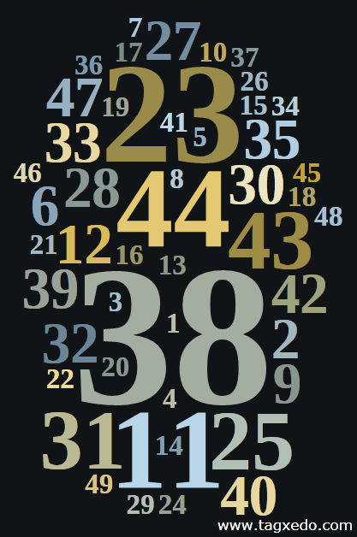
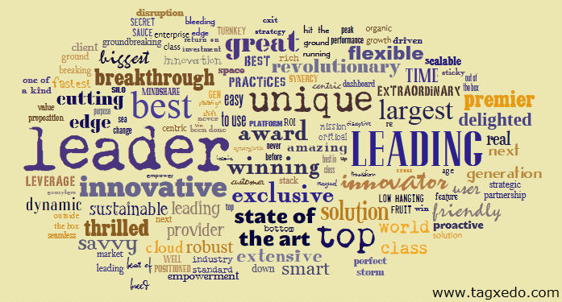
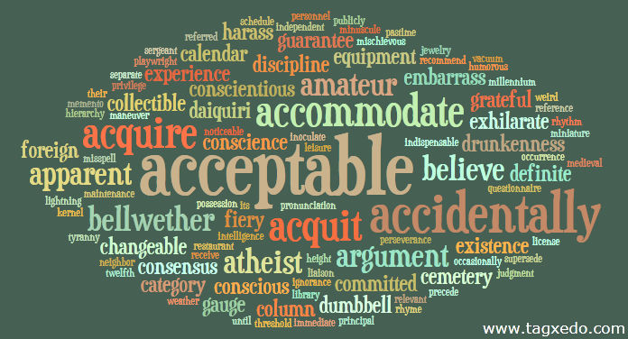
Visualize Most Any Textual Data
Most any textual data, formal or informal, can be visualized in Tagxedo, often offering interesting perspectives
List of common misspelled words
Overused marketing terms
Lotto statistics
Tips
Normalize frequency when appropriate
Using all fonts conveys diversity
Lotto winning
likelihood
overused in marketing
often misspelled

Slide 46
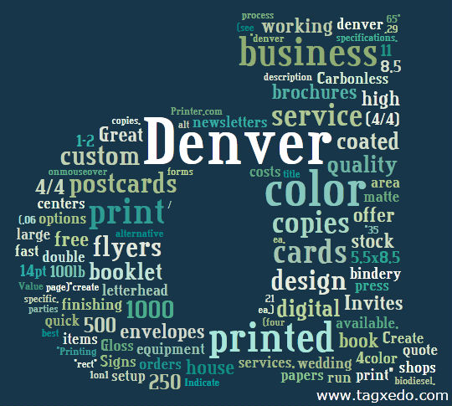
Tell People What Your Company Does
List keywords describing your company and use "Normalize Frequency"
Use your company logo or initials
Single letter often looks very good
Some "fat" fonts work very well with initials
e.g. Fette Egyptienne
Signs, posters, store front displays, etc.
Tagxedo ("t")
A Denver printing
company ("d")

Slide 47
Make a Business Card Design
Add a Tagxedo to the back of the business card
No need to repeat what's in the front (email, phone #), but use it as an extended introduction
Remind people what you do, or what you offer
Normalize frequency
Use a different font/color for your name
Use custom shape (hard to get it right) or classic cloud

Slide 48
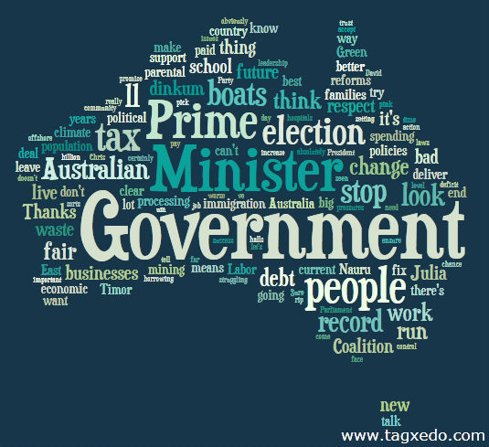
Contrast Candidates in a Political Debate
Tagxedo provides a first-order analysis
Debates, speeches, slogans, promises, etc.
The following example compares the words of Julia Gillard (incumbent) and Tony Abbott in the Australian election debate (July 25, 2010)
Normalized Frequencies
show relative, not absolute, importance of words
Gillard said "I believe" and "Australian people" a lot
Abbott frequently laid blame at the "Government"
Julia Gillard
Tony Abbott

Slide 49
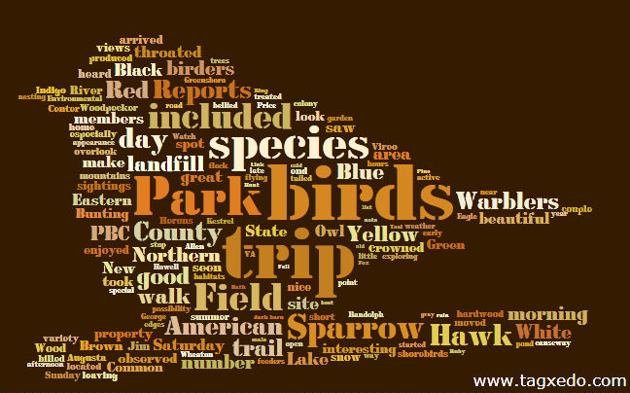
Summarize a Field Trip Report
Make a Tagxedo out of your field trip report
Use related shapes
Example
A bird watching field trip
Each student writes his/her own report
Each group (of 5 students) write a more comprehensive report, complete with pictures and research
A Tagxedo is made of the words in the report and shape of a bird (actual picture)

Slide 50
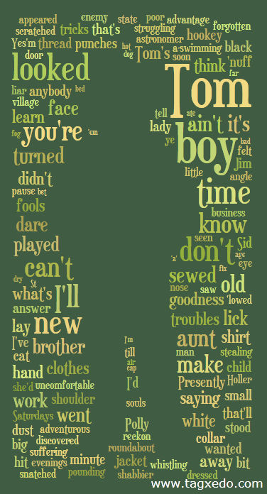
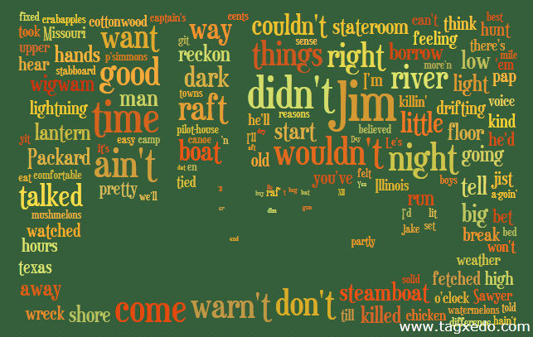
Summarize Chapters of a Book
Summarize chapters of a book
Use text from the chapter
Highlight selected words to summarize the chapter or lead to the next
Use related shape
Example: Tom Sawyer, steamboat (silhouettes)

Slide 51
Appreciate Other Languages
Make Tagxedo with non-Latin languages
Chinese, Japanese, Korean, Hebrew, Russian, ...
Classic poems, literatures, etc
Also try Google Translate
e.g. translate "The Road Not Taken" to Chinese
Consider the "NonLatin Heuristics" option. On? Off?
Use custom fonts (e.g. free Chinese font here)
Excellent learning opportunity
Introduce other cultures / appreciate diversity of writing languages / great for group project

Slide 52
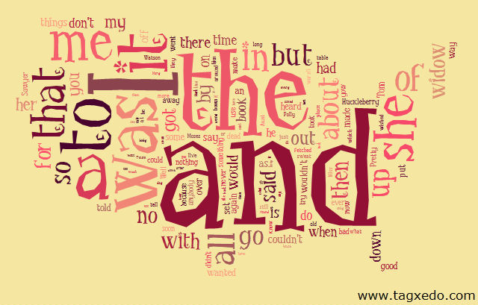
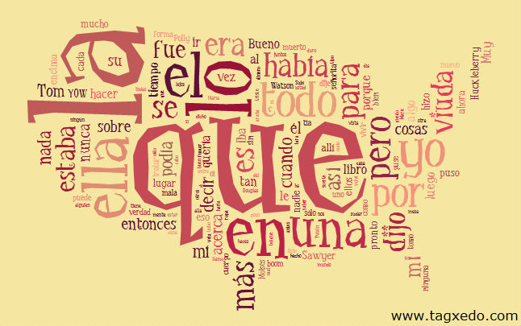
Make a Language Art
Make multiple Tagxedoes of a famous literature
Original + multiple translations
Either turn off common word removal, or manually remove them in the translations as well
Use Google Translate as a backup solution
Compare and contrast the words
Make a nice artwork display
Crazy idea:
English to Chinese to English!
Adventures of Huckleberry Finn in English, Spanish, and Chinese

Slide 53
Turn Your Name into an Artwork
Repeat your name 200 times
Set "Combine Identical Words" to "No"
Set "Normalize Frequency" to "Yes
Tagxedo will size the words according to Zipf's Law
Set "Font Preference" to "All"
Idea
Room signs, stickers, portfolio inserts
Just don't brag about it, okay?

Slide 54
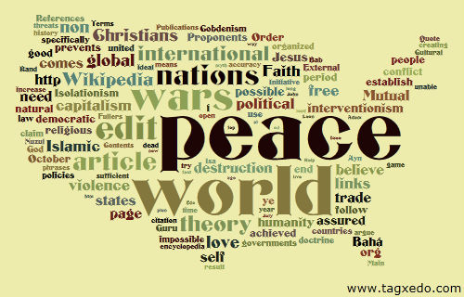
Use Tagxedo as a Font Evaluator
Save Font File (TTF, OTF, .ZIP) from Font Websites (e.g. DaFont, FontSquirrel)
Use the "Add Font" feature to load the font
Excellent way to evaulate and compare fonts

Slide 55
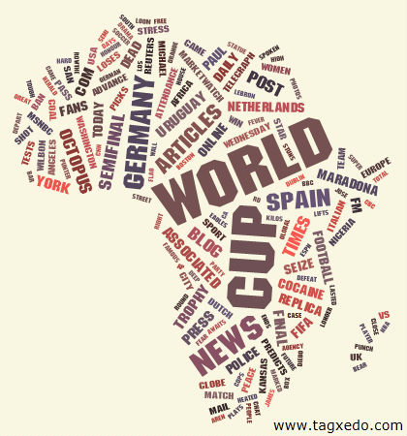
Make a Clickable Tag Cloud for Your Site
Silverlight-based
Animated Words
Clickable
Require SL
Image-map-based
No animation
Clickable
No Flash/SL/JS required
See Blog for details

Slide 56
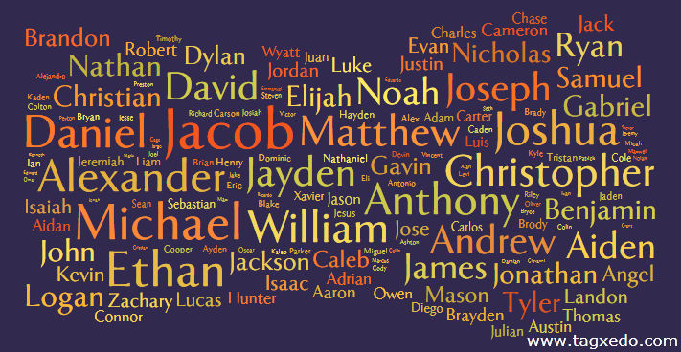
Name a Baby
Collect a list of candidate names, assign them with different weights (say between 5 and 100).
Create a Tagxedo using the classic cloud
See how your favorite names stand out in the presence of others
Adjust weights, and repeat (lock theme, font, and orientation)

Slide 57
Juice up Important but Boring Documents
Safety manuals, terms and conditions, legal documents, reference manuals
Turn them into Tagxedoes
Get a gist of what it is about (many have confusing titles)
Normalize frequency if necessary
Helpful if desirable to promote certain keywords (give them very high frequencies and then normalize)

Slide 58
Pick a Theme
Use Tagxedo to pick a theme (palette)
Wedding invitation, marketing event, personalized palette, stationery, corporate theme, etc.
Better visualization than the raw colors side by side
Tips
use history mode for comparison
Set "Theme Preference" (any, bright, dark)
Add your own theme to Tagxedo to visualize

Slide 59
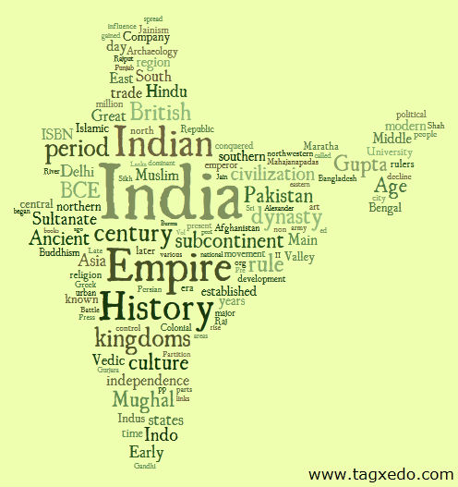
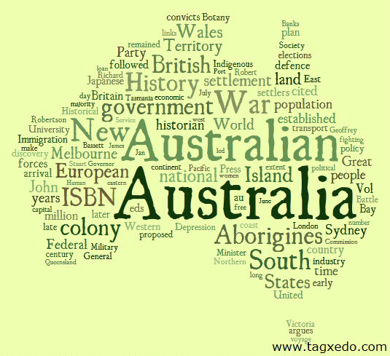
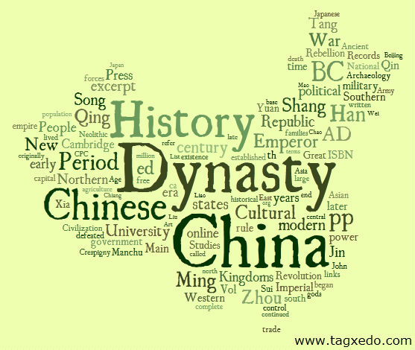
Teach Students about Cultures of the World
Fun way to learn geography, history, and culture of different countries
Great for projects
One country per student/group
Research, Prioritize words, Make Tagxedo, Give presentation
Turn the Tagxedoes into beautiful posters

Slide 60
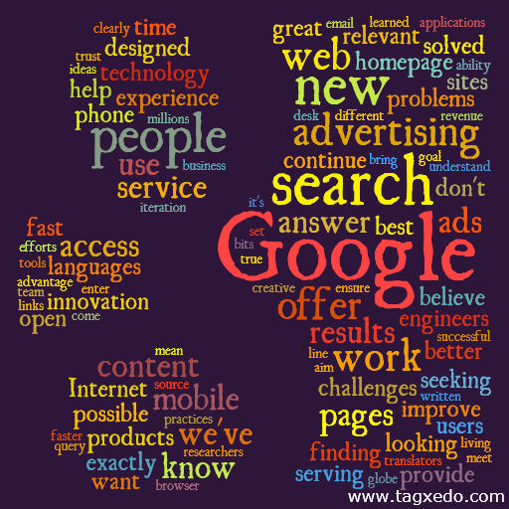
Present Your Corporate Mission Statement
Present the (otherwise boring) Mission Statement in a more colorful way
Use the mission statement as is (better), or hand craft the words
Starbucks
(Class Cloud)
Google's Philosophy
(the "g" Cloud)

Slide 61
Teach Students about the States
Similarly, students can learn about the States by researching and making Tagxedo with shapes of the States
Bonus idea
Take out the names of the states and ask sutdents to guess the States
Use bigger words for the state flowers, Capitols, and animals, and big cities

Slide 62
Capture Fond Memories
Turn your fond memories into a Tagxedo
Childhood fun
Summer vacation
Visiting love ones
Write an essay, or write down words or short sentences
Tip: Adjust frequency to highlight favorite activities
Perfect gift to grannies after visiting them

Slide 63
Make a Unique Gift
Easy to turn your unique Tagxedo artworks into a T-shirt, hoodie, etc.
Try the "Make a T-shirt (beta) feature
Merchants: expand your product line with Tagxedo customization
rich customization options available
email licensing@tagxedo.com

Slide 64
Improve Your Writing
Turn your own writing into a Tagxedo (blog, diary, essay)
Make ' (single quote) a punctuation exception
so that you can see words like don't, should've, I've
Take out frequent words not related to style of writing
Make a Tagxedo that is comfortable to read
classic cloud, horizontal, ChunkFive, bright theme
Are certain words used too often?
want, feel, don't, going, things, ...
Repeat this with some good writing, and compare

Slide 65
Make a One-of-a-Kind Birthday Card
Example (it's really easy!)
Just repeated "Happy Birthday to You" and the name
More mastery of the options = More creative you can be
Many possibilities to make highly customized one-of-a-kind birthday cards

Slide 66
Make Your Own Mother's Day Card
Find words to describe your mother
Her personalities, music she enjoys, places she loves
Normalize frequency

Slide 67
Bid Farewell to a Friend with a Tagxedo Card
Make a farewell card for a departing good friend
Add his/her name, and names of his/her close friends
Choose words to express love, farewell, and goodbye (the following example Tagxedo is made of a collection of farewell poems)
Important: proof read the words!
Sign your names

Slide 68
Enrich Your Diary
Three ways to enrich your diary
Decorate your diary with Tagxedo every month
Write a Tagxedo entry - just enter words in order of importance (+ normalize frequency)
When you have tons of emotion but just can't write
Write down the lyrics of a song that reflects your mood
Normalize frequency, custom theme, custom color
"Sometimes" by Carpenters

Slide 69
Make an Activity Poster
Great for camps, zoos, parks, festivals, church activities
Just enter the words that best describe the offering
Easiest: score each activity, then normalize frequency
e.g. dancing:59 basketball:70 lunch:20
Make multiple posters with the same theme/font, but different weights to highlight different activities (or different days in the camp)

Slide 70
Add Captions to a Music Video
Tagxedo allows many creative ways to do that
Example (Sometimes by Carpenters)
Enter the whole lyrics into Tagxedo
Normalize frequency, Don't combine related or identical words and don't remove common words
Highlight current sentence by doubling its frequency
Highlight important words with a different color
Try listening to the song while reading this!

Slide 71
Make a Tagxedo Guessing Game
Turn famous writings into a Tagxedo guessing game
More challenging: Hide the top 3 words

Slide 72
Make a Guess-the-Quote Game
This is a brand-new game but very easy to make
Use all words from a quote, and some not from it
Similar and related words are great
Normalize frequency, also careful with options
Goal is to guess the quote (a la Wheel-of-Fortune)
Use "Deja Vu" option to reveal the answer
Variation: Give hints ("buy a word"), make it more difficult with more words, always reveal the first word

Slide 73
Make a Resume/Recommendation Cloud
Two uses
Summarize your resume
Highlight recommendations made by others about you
Pick and choose significant words
Use "Normalize Frequency" for a smooth distribution
Uniquely about you
Can make you stand out if complemented with a solid offering and a good dose of modesty
Resume (demo)

Slide 74
Make a Simple Party Poster
Just a few details
Occasion, place, address, phone, contact, RSVP
Normalize frequency
Custom color

Slide 75
Condense a Court Document
Condense any court ruling into a visually appealing form
Lead-in for class discussion
Example
Full text of Judge Vaughn Walker's 163-page ruling on the gay marriage ban (Proposition 8)

Slide 76
Make a List of Favorite Cities You've Visited
... Or a list of your dream vacation destinations
Order the destinations by how much you like them
Use the "Normalize Frequency" feature to automatically assign frequencies
Adjust the "Spread" to your liking

Slide 77
Teach ABC
Make a pictorial introduction to ABC
Eye catching pictures
Use "Deja Vu" to make same layout but different colors
Many variants, adaptable to different age group
Hunt for letter T
Recognize the words
What's that color
Customize to child's need
use real names
favorite colors

Slide 78
Stimulate Early-Childhood Learning
Turn a familiar song into a Tagxedo
Ask child to recognize words (and provide ample hints)
He/she will soon get it and eager to guess the words
Ask him/her to sing it out loud while pointing at the words
Build confidence and interest in words
Fun game to play
Ask child to name his favorite songs to play the game with

Slide 79
Make a Fun Personality Test, With Friends
Part I: Rank a list of top 20 core values
family, friendship, accomplishment, wealth, health, etc
tips: give each value a score (0-100), and then sort
Make a Tagxedo with normalized frequency
Part II: Variations for two people
Compute the difference between the ranking of values
Frequency = Absolute delta, Red if +ve, Blue if -ve
Highlight difference between the two
Bigger words = larger difference, Color indicates whether you care more or less
Maybe I'll make a simple app to make this easy?

Slide 80
Show Your True Color
Make a Tagxedo with 100 words best describing you or your friend
Adjust frequencies to highlight personality
Bonus: color effect
Make a T-shirt, a mug, or a poster
Truly one of a kind
Great birthday gift

Slide 81
Learn More about Yourself
Each student writes 5 adjectives about each of his/her classmates
All adjectives are collected and each student choose and rank 40 adjectives that best describes himself/herself
Make a Tagxedo of adjectives others choose to describe you
Make a Tagxedo of adjectives you choose to describe yourself
Compare the two
Best to use "Deja Vu" option (same word = same color)
Use "Normalize Frequency" (to show ranking)

Slide 82
Capture the Collective Wisdom
Ask a question and solicit short replies from people (exactly 6 words, at most 140 characters, etc)
How to be happy?
How to improve our schools?
How to fix the economy?
Build a Tagxedo with the response
Capture the collective wisdom
Happiness is ...

Slide 83
Make a Speaker's Biography
Give your keynote speaker a specical treat with a Tagxedo biography about them
Example
Don Marinelli, Professor of Drama and Art Mgmt at CMU
Keynote, SIGGRAPH 2010
Classic, logo, or portrait
Portrait
Classic
Cloud

Slide 84
Create a Conference Session Poster
Make a poster for each session
At-a-glance summary of the topics

Slide 85
Brainstorm a Topic
Use Tagxedo as a brainstorming tool
School - class discussion, debate, research
Marketing - buzzword analysis, idea generation
Copy and paste text from multiple sources
Wikipedia, news, forums
Optionally use "Normalize Frequency" to tone down the top words, or simply skip them
Original (green energy)
Top obvious words removed

Slide 86
Recommend Local Attractions to Visitors
Welcome your foreign visitors with your own local recommendations
Tourist attractions
Food, entertainment, best bargain
Bonus attractions only locals know
Order the recommendations, and use the "Normalize Frequency" feature
Can you guess where this is?

Slide 87
Create a Synonym Word Wall
Look up synonyms of overused words at thesaurus.com
Beautiful, Exciting, Really, Love, Hate, Think
Cut and paste all the synonyms to Tagxedo
Add the original word, make it stand out (font/color/size)
Add diversity with "Normalize Frequency" and/or "All Fonts"
Make it a personal or group project (e.g. 2 words per student)
Post to wall, make a book
Encourage more creative writing

Slide 88
Present Statistics Visually
Present statistics visually
<word>:<frequency>
To show ranking use "Normalize Frequency"
Examples
US cities by population
British and Chinese surnames by popularity

Slide 89
Make a Poster of Your Favorite Movies
Make a list of 100+ of your favorite movies
Use the "Normalize Frequency" option.
Make a unique Tagxedo

Slide 90
Find Out Which Words are Popular in ...
Get a list of words, put it in Tagxedo and see which words are popular
book titles, baby names, tweets among friends, ...
Example adapted from the blog post Life & Death in YA Lit
Author conjectured that "dead" is the word of the year in Young-Adult titles
Prove it with a word cloud (341 titles)

Slide 91
Write a Book
Make a Tagxedo book on your favorite topics
Animals from A-Z
Different breeds of dog
Transportation
Countries and cultures
Your school life
Research about the topics and make a Tagxedo with the text
Accompany the Tagxedo with some text
Group project
Consider publish it!

Slide 92
Take a Quick Class Poll
Interesting visualization of polls
What's your favorite color?
Top-three locations (out of 20) for class outing?
Great for real-time poll

Slide 93
Make a Find-the-Words Game
Make a Tagxedo, some animal names, some not
Instead of mammals, you can also Bible characters, color names, cities, capitals of countries, ...
Make two versions, one showing the answer and one not
Ask the children to find all animals
Make it a timed game (or untimed for tricky topics)
Use "Deja Vu" so both have the same word placement
Use custom theme and color to reveal the answers
Many variations
e.g. find 3 carnivores that live in Africa

Slide 94
Conduct a Sentiment Analysis
Kauffman Foundation asked a group of (~40) bloggers to describe the economy in 5 adjectives (see report here)
The result is turned into a Tagxedo, which clearly reflects the mood

Slide 95
Turn Your Thesis into an Artwork
Turn months or years of your hard work into an artwork
Add your thesis title to the Tagxedo
Easy to do with normalized frequencies
The following is the MS thesis titled "Artistic Rendering of Portrait Photographs" by Eric Wong (140 pages)
Use related shapes
Add it to your thesis
Great gift to parents

Slide 96
Build Your SAT Vocabulary
Collect a list of essential words
100, 500, 1000, 5000 words
Make a Tagxedo with 100 words each
Normalize frequency, easy-to-read font
Turn each Tagxedo into a flashcard
Review, and circle words that you don't know
Collect the circled words, repeat the exercise
Put tricky words on top (so they are bigger)
I may make an app for this

Slide 97
Debrief Your Audience
After a lecture, rejuvenate your audience with a Tagxedo
Especially good for dry or serious topics
Replace the "Summary" or "Learning" slide
Two methods
Let Tagxedo sizes the words based on the text
Use "Customize Words" to show the text in relative frequencies, and come up with your ranking
Go through the key points again
Lead your audience through the important topics
A Lecture about the Cold War

Slide 98
Summarize a Blog Post
Any blog post can be visually and pleasingly summarized
Advantages
Provide a different perspective on the topics
Give the audience a quick overview (great for the TL;DR generation)
Juice up topics lacking supplemental visuals or images
Why not? Just for fun!
A blog post about Android "reimaged" with Tagxedo

Slide 99
Use Tagxedo as a Background Image
Using words from your presentation
Choose a compatible theme
Use an image editor to brighten or darken the words
Optionally crop the Tagxedo to maintain aspect ratio
Don't over do it

Slide 100
Visualize a Poll
Favorite artists, Atheletes of the Year, Person of the Year...
Use tilde (~) and colon (:)
North~Korea:659141
Where Justin Bieber should tour
Because of an Internet prank, some countries are voted disproportionally
Normalize Frequency may help
Actual
Frequencies
Normalized
Frequencies

Slide 101
Outline a Syllabus
What text to use
The Syllabus
Actual course material
A prioritized list of key concepts (this works best)
How to show it
Classic cloud or course-related images both work
For list of prioritized concepts, "Normalize Frequency" gives good result
Example shown
Stanford CS 448A, Computational Photography, Spring 2010

Slide 102
Make a Guess, Win a Prize
Make a Tagxedo of a subject
Travel destination, celebrity, famous novel
Take out all obvious keywords, but leave enough clues in
Guess where/who/what
Plenty of learning opportunities
Encourage students to do their own researches
Collaborative guesses (group of 5, 20 puzzles)
Students give presentation about the places
Bonus: make an extra (but subtle) hint with the shape
Answer
Answer

Slide 103
Track a Poll Over Time
Track data evolving over time
College football ranking (weekly or annual)
For rankings, use "Normalize Frequency"
Use "Deja Vu" for better comparison
Same word has the same color across all runs
Week 0
Week 8
Final
Week 12

Slide 104
Kill Some Time
Make a Tagxedo whenever you are bored, and very soon you'll have an impression collection of visual art
Warning: time may mysteriously disappear

Slide 105
Resources
Home www.tagxedo.com
Gallery (300+ examples) www.tagxedo.com/gallery.html
All Things Tagxedo blog.tagxedo.com
Announcement, news, idea, tips
Daily Tagxedo daily.tagxedo.com
Current events, trending topics, ideas of the day
Celebrity Tagxedo celebrity.tagxedo.com
Portrait of famous people, notable personalities
Forum, FAQ

