Slide 1
Cubism
Art movement

Slide 2
Beginnings
Cubism is an early-20th-century art movement which brought European painting and sculpture historically forward toward 20th century Modern art.
Cubism in its various forms inspired related movements in music, literature and architecture.
Cubism has been considered to be among the most influential art movements of the 20th century.

Slide 3
Basic characteristics
In Cubist artwork, objects are analyzed, broken up and reassembled in an abstracted form—instead of depicting objects from a single viewpoint, the artist depicts the subject from a multitude of viewpoints to represent the subject in a greater context.

Slide 4
Main cubists
The movement was pioneered by Georges Braque and Pablo Picasso, joined by Andre Lhote, Jean Metzinger, Albert Gleizes, Robert Delaunay, Henri Le Fauconnier, Fernand Léger and Juan Gris.

Slide 5
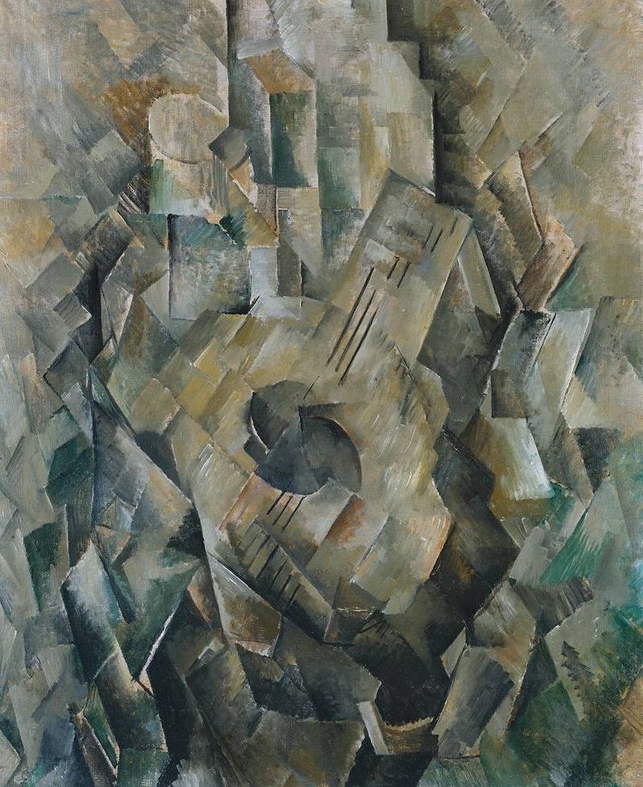
Georges Braque

Slide 6
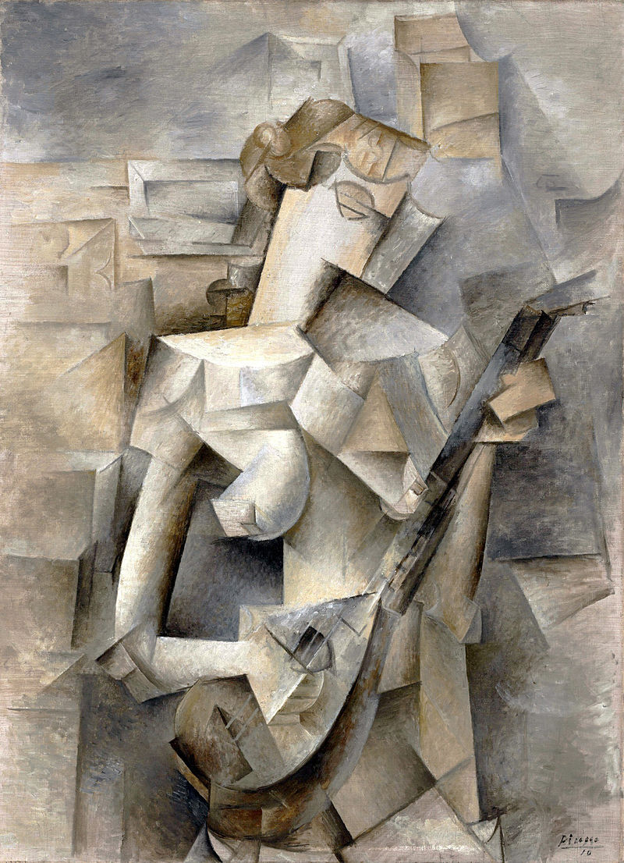
Pablo Picasso

Slide 7
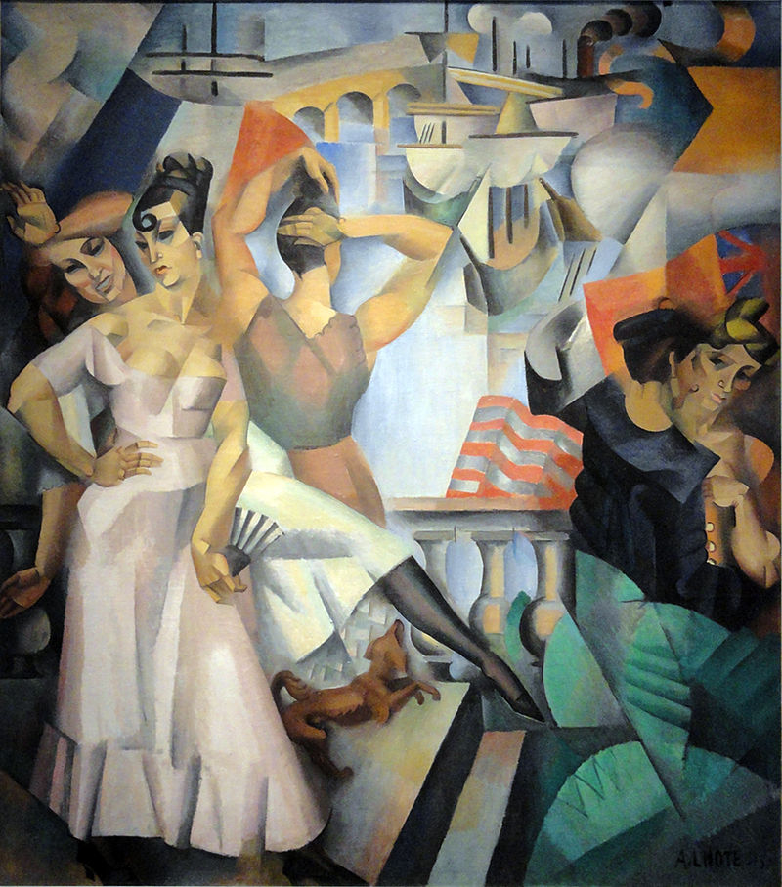
Andre Lhote

Slide 8
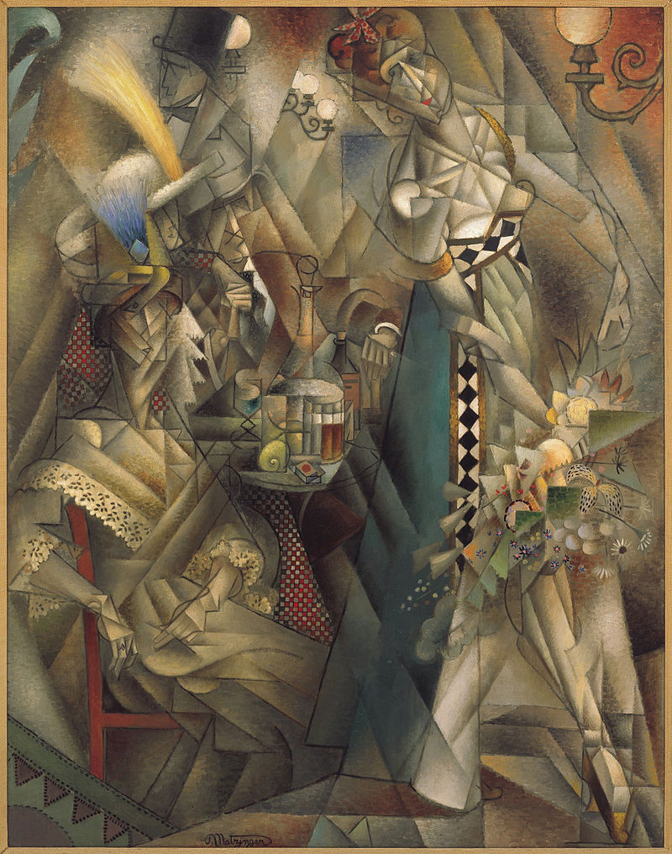
Jean Metzinger

Slide 9
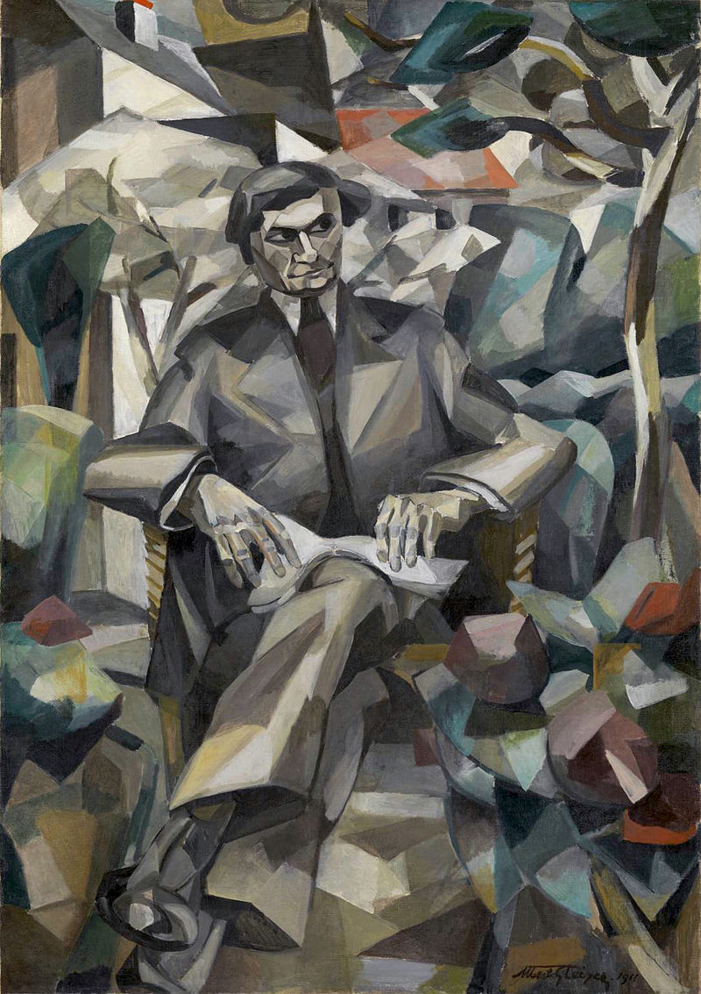
Albert Gleizes

Slide 10
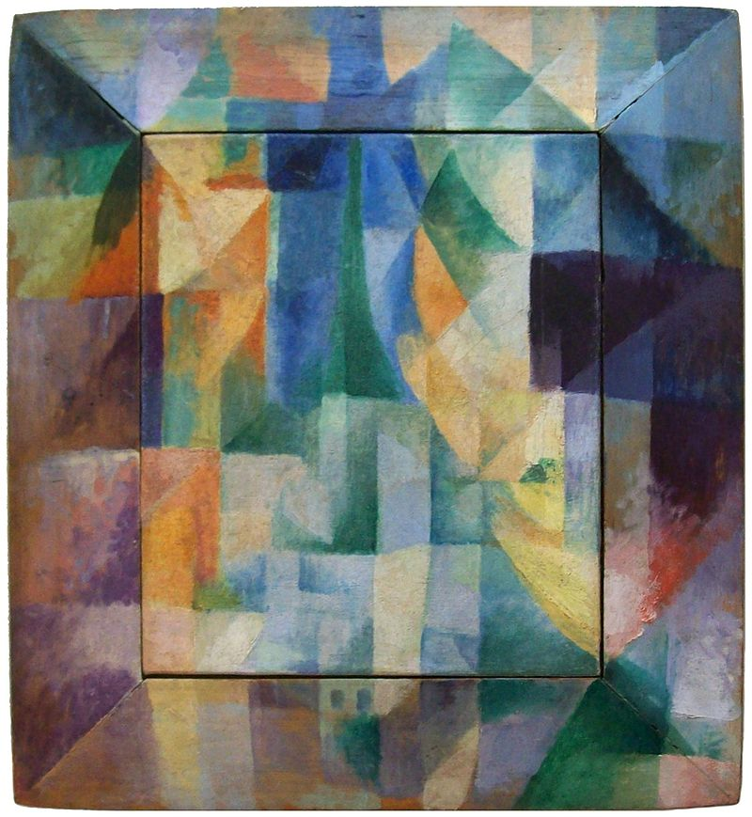
Robert Delaunay

Slide 11
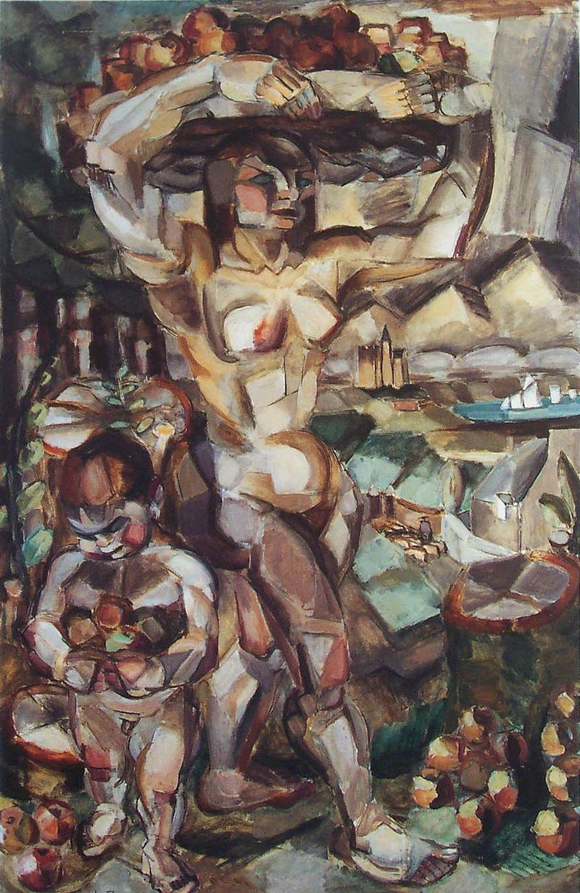
Henri Le Fauconnier

Slide 12
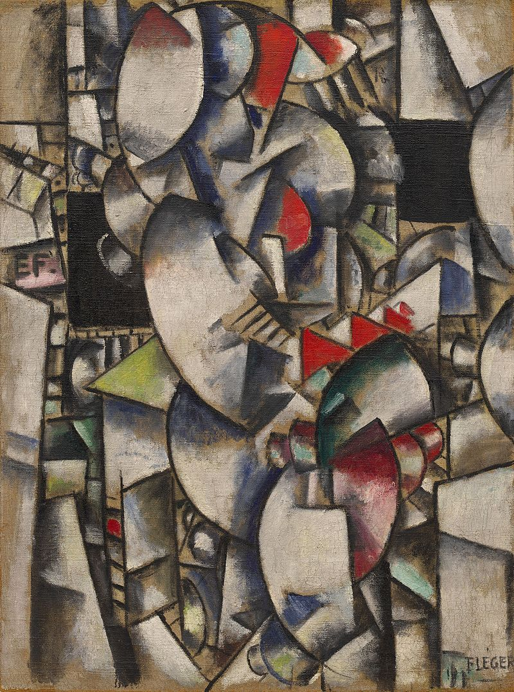
Fernand Léger

Slide 13
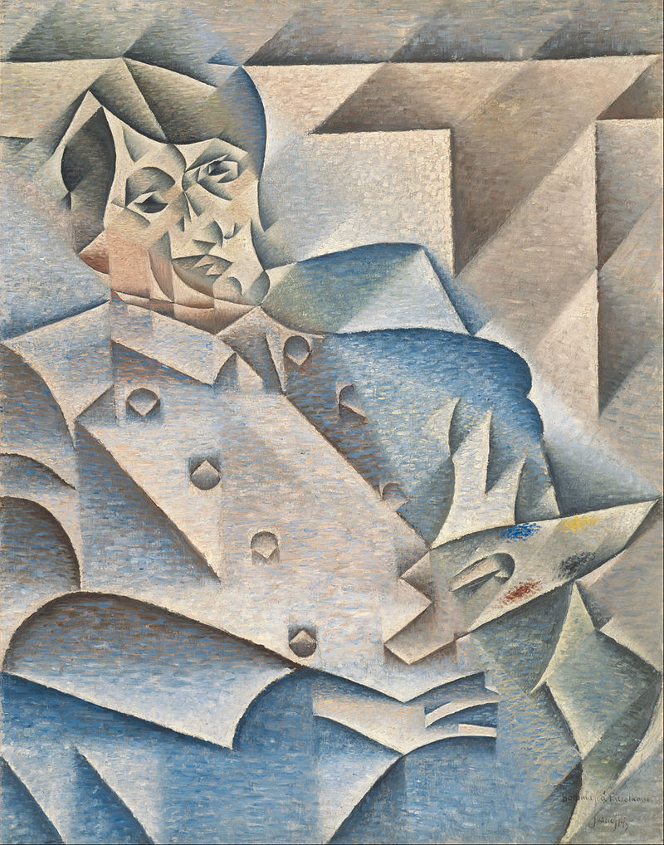
Juan Gris

