Slide 1
Expressionism
Art movement

Slide 2
Beginnings
Expressionism was a modernist movement, initially in poetry and painting, originating in Germany at the beginning of the 20th century.
Expressionism was developed as an avant-garde style before the First World War. It remained popular during the Weimar Republic, particularly in Berlin.

Slide 3
Basic characteristics
The style extended to a wide range of the arts, including expressionist architecture, painting, literature, theatre, dance, film and music.
Its typical trait is to present the world solely from a subjective perspective, distorting it radically for emotional effect in order to evoke moods or ideas.
Expressionist artists sought to express the meaning of emotional experience rather than physical reality.

Slide 4
Main Expressionists
Edvard Munch,
Franz Marc,
Paul Klee,
August Macke.

Slide 5
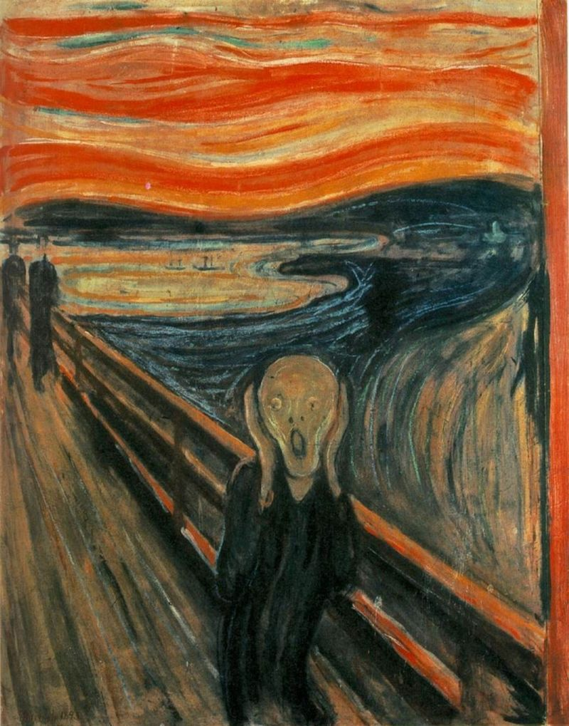
Edvard Munch

Slide 6
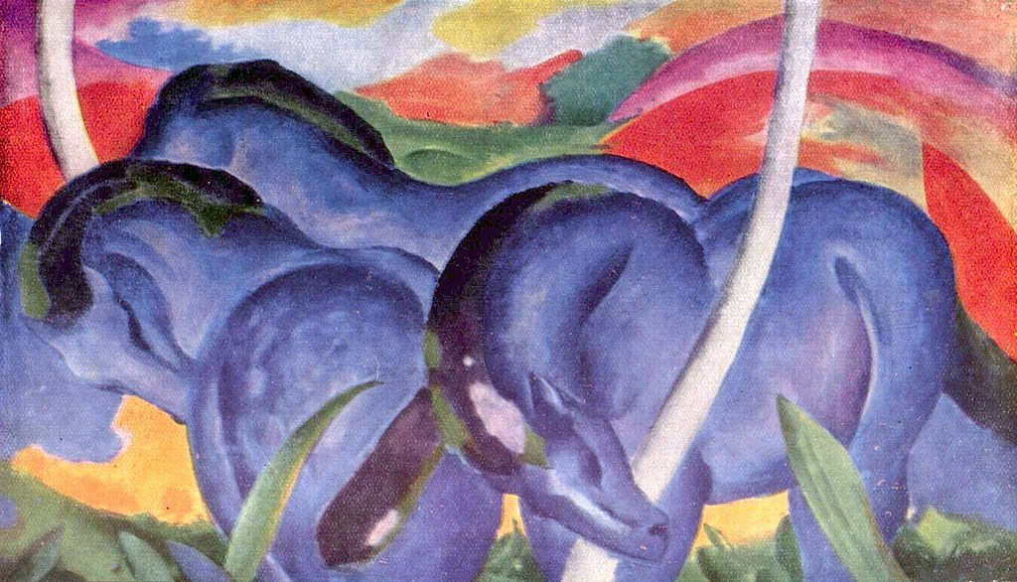
Franz Marc

Slide 7
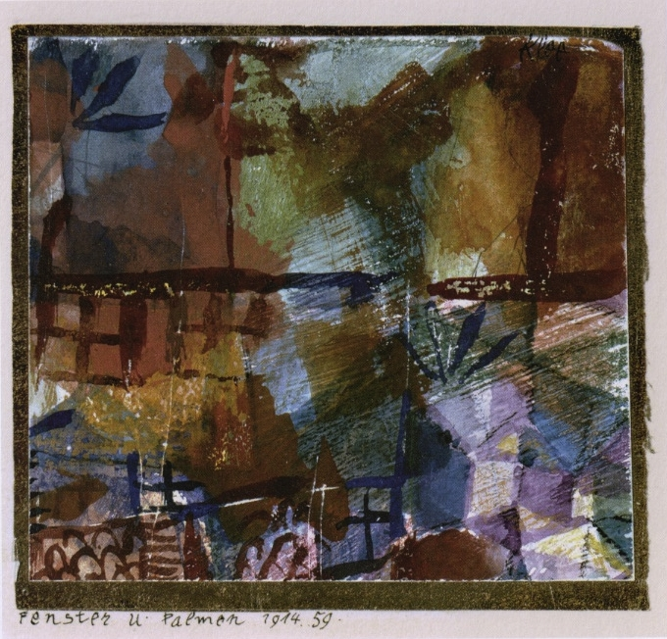
Paul Klee

Slide 8
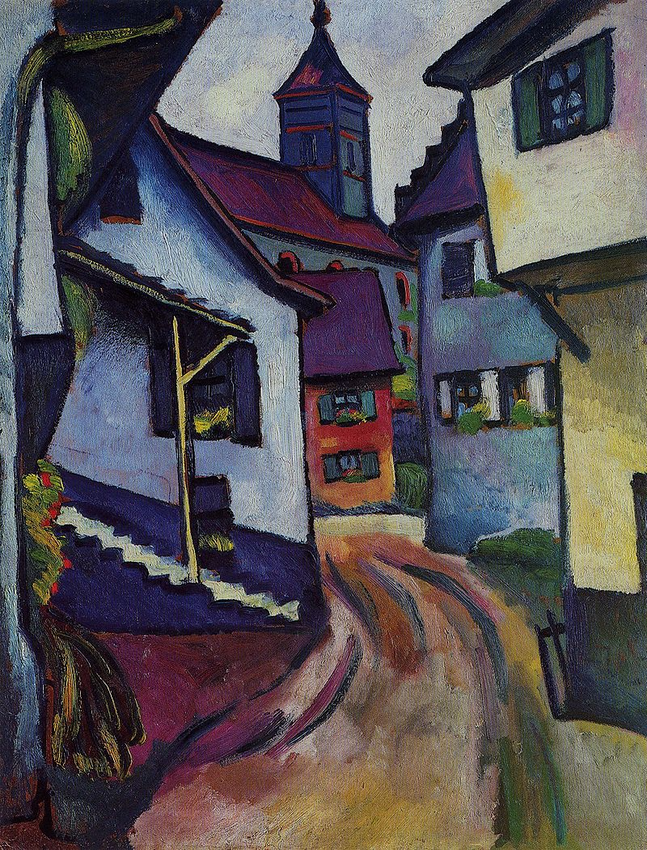
August Macke

