Slide 1
Vangel Kodzoman
Modern Macedonian artist

Slide 2
Vangel Kodzoman
Vangel Kodzoman was born on 14th February 1904, in Struga.
He went to school in Ohrid, where he graduated at the Ohrid gymnasium in 1923/1924.
He finished the teaching branch at the School of Art in Belgrade from 1924 till 1928.

Slide 3
Creativity of Vangel Kodzoman
The entire artistic opus of Vangel Kodzoman was generated nearly half a century (1928-1976). He created about 2.500 paintings in different techniques: oil, watercolor, pastel, distemper paints, mosaic, stained glass, etc.
The thematic determination of Kodzoman is diverse; he built traditional iconography in his painting almost on all painting motive nudes – portraits, still nature, historic portraits and compositions. His interest in landscapes is dominated, primarily in the landscape of his homeland which is recognizable for its coloristic expression.

Slide 4
Creativity of Vangel Kodzoman
First of all, Kodzoman is a Macedonian painter, an expressive painter of landscape and a registrator of portraits of everything that surrounds us and everything that passed by.
The name and the creations of Vangel Kodzoman are built in the foundations of Macedonian modern art. He is an artist and one of the few who in the early thirties of the last century, in historic unsuitable conditions, he began his creative activity.

Slide 5
Works by Vangel Kodzoman

Slide 6
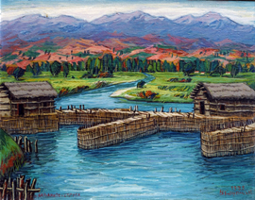

Slide 7
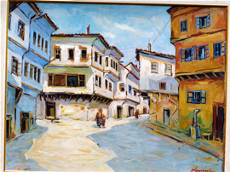

Slide 8
