Slide 1
Nikola Martinoski
Modern Macedonian art

Slide 2
Nikola Martinoski
Nikola Martinoski was born on 18th August, 1903, and he passed away on 7th February, 1973.
Martinoski is a Macedonian artist and academic and he is one of the most important people for the development of the Macedonian culture in the 20th century.
Martinoski graduated at the Academy of Fine Arts in Bucharest, Romania in 1927 as the best student for that year.

Slide 3
Life of Nikola Martinoski
Nikola Martinoski started his primary education in an Aromanian school in Skopje.
He attended a Serbian and Bulgarian school where he showed interest for drawing things together with the icon-painter Dimitat Andonov where the both of them acquired knowledge about icon painting and painting.
After the death of his father Kosta Martinoski, he was not in a good financial situation, but he still succeeded to continue his education in Bucharest, from 1920 – 1927, where he attended the Academy of Fine Arts. He attended the courses about drawing, decorative art and sculpture.
At the end of his studying, Martinoski was awarded the first prize for painting in his generation.

Slide 4
Life of Nikola Martinoski
After his studies, he stayed a short time in Skopje where he took part in the city’s artistic life.
Martinoski drew, painted and illustrated books.
He was a freelance art director in the Theatre of Skopje for a season (1939-1940) and wrote e few articles on the artistic life.
He kept company with some exceptional people from the cultural life of Skopje who followed his career.

Slide 5
Creativity of Martinoski
Nikola Martinoski showed interest in drawing during his first school years in Skopje.
He learned a lot in the workshop of the icon-painter Dimitar Andonov Papradishki (1859-1954).
Martinoski created his first works until 1920, mainly with motives borrowed from colored postcards.

Slide 6
Creativity of Martinoski
In Bucharest, in the Academy of Fine Arts, Martinoski gained full professional education. He met with the Romanian Art at that time which was under the influence of certain tendencies towards the expressionism.
Martinoski created some of his works which are important for his development as an artist during these school years. He started with embellished portraits, but finished with characters that were made with consistent artistic expressions (“A Portrait of a Romanian Gipsy”, “A Head of a Child”, 1926).
Martinoski was awarded the first prize for painting at the very end of his studies for the painting “A Female’s Nude” influenced by Camille Resul. This work has a reliable and solid drawing with deepened, slightly graded dark ochre colors (1927).

Slide 7
Creativity of Martinoski
His stay in Paris is of significant meaning for the development of his career. At that time, a range of modern art movements were developed. Their influence and the presence of many foreign artists contributed to the emergence of the so-called the School of Paris.
Matinoski (just like Lichenoski) took part in the exhibition of Yugoslav artists in Paris, in 1928 with two landscapes that are not famous today.
Here, he created other paintings with elements taken from Parisian examples: “Head of a woman”, “Female’s Nude with a Hat” and “A Lady with a Cat”, then “The Chess players” that belongs to the post cubic expressionism: the males figures are massive with square shapes and expressive forms of the bodies and heads.

Slide 8
Works by Martinoski

Slide 10
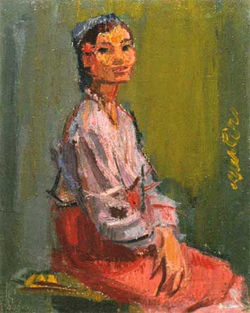

Slide 11
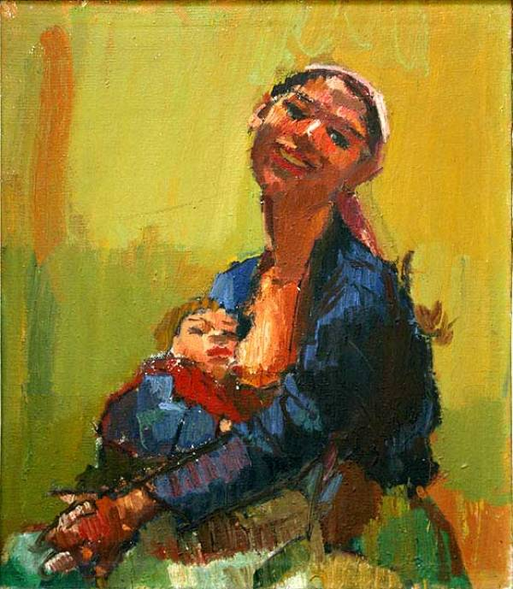

Slide 12
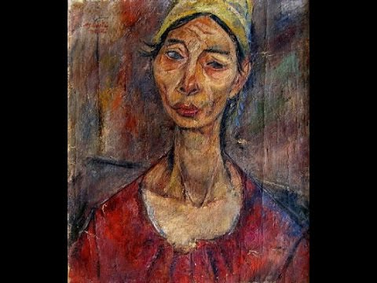

Slide 13
