Slide 1
Post-Impressionism
Art movement

Slide 2
Beginnings
Post-Impressionism is a predominantly French art movement that developed roughly between 1886 and 1905.
Post-Impressionism emerged as a reaction against Impressionists' concern for the naturalistic depiction of light and colour.
Due to its broad emphasis on abstract qualities or symbolic content, Post-Impressionism encompasses Neo-Impressionism, Symbolism, Cloisonnism, Pont-Aven School, and Synthetism, along with some later Impressionists' work.

Slide 3
Basic characteristics
Post-Impressionist artists were not in agreement concerning a cohesive movement. Yet, the abstract concerns of harmony and structural arrangement, in the work of all these artists, took precedence over naturalism.
Artists such as Seurat adopted a meticulously scientific approach to colour and composition.

Slide 4
Main Post-Impressionists
Paul Cézanne,
Paul Gauguin,
Vincent van Gogh,
Georges Seurat.

Slide 5
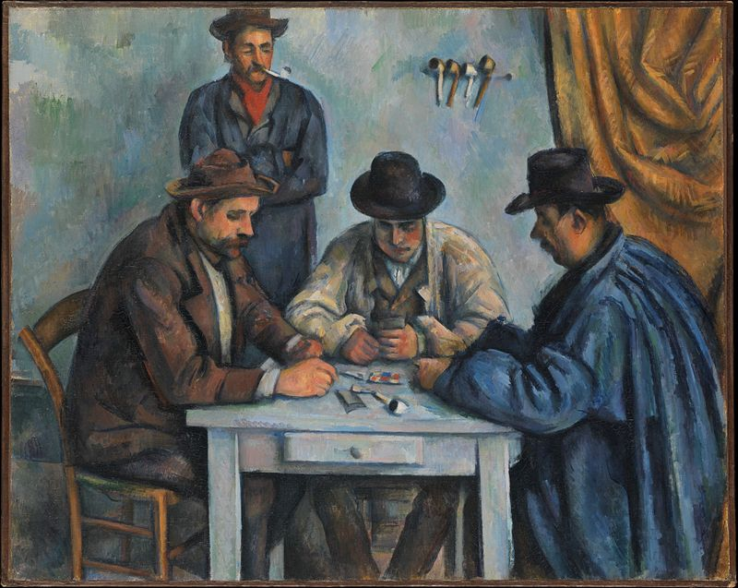
Paul Cézanne

Slide 6
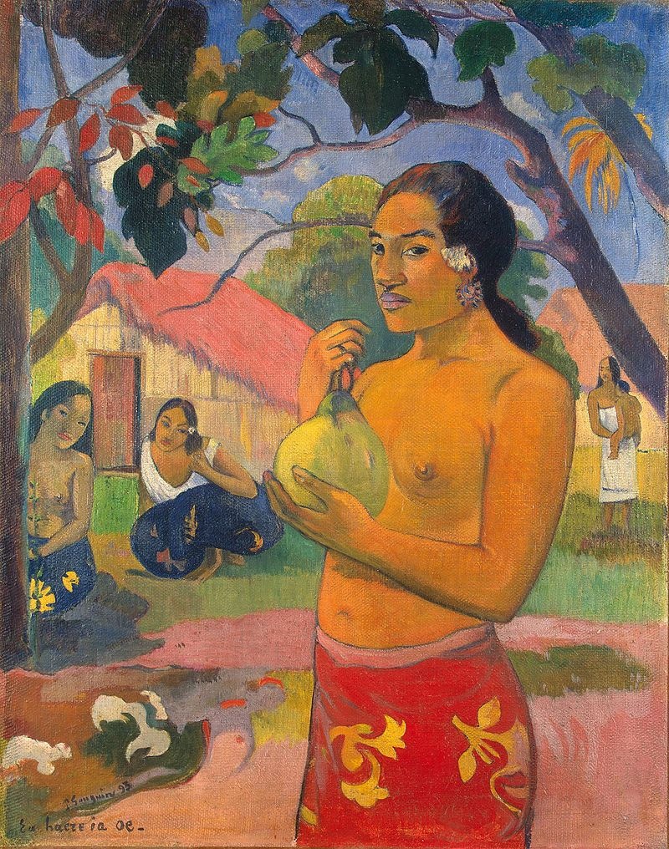
Paul Gauguin

Slide 7
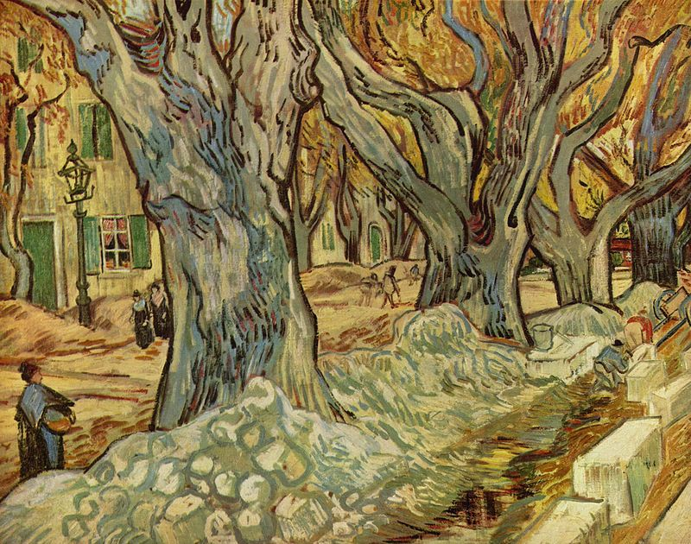
Vincent van Gogh

Slide 8
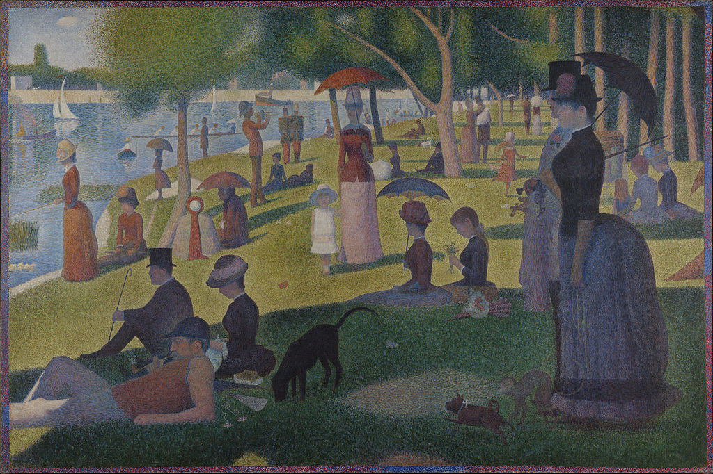
Georges Seurat

