Slide 1
Realism
art movement

Slide 2
Beginnings
Realism was an artistic movement that began in France in the 1850s, after the1848 Revolution.
Realists rejected Romanticism, which had dominated French literature and art since the late 18th century. Realism revolted against the exotic subject matter and exaggerated emotionalism and drama of the Romantic movement.

Slide 3
Basic characteristics
Instead emotionalism and drama realists sought to portray real and typical contemporary people and situations with truth and accuracy, and not avoiding unpleasant or sordid aspects of life.
Realist works depicted people of all classes in situations that arise in ordinary life, and often reflected the changes brought by the Industrial and Commercial Revolutions.

Slide 4
Main realists
Jean Désiré Gustave Courbet led the Realism movement in 19th-century French painting;

Slide 5
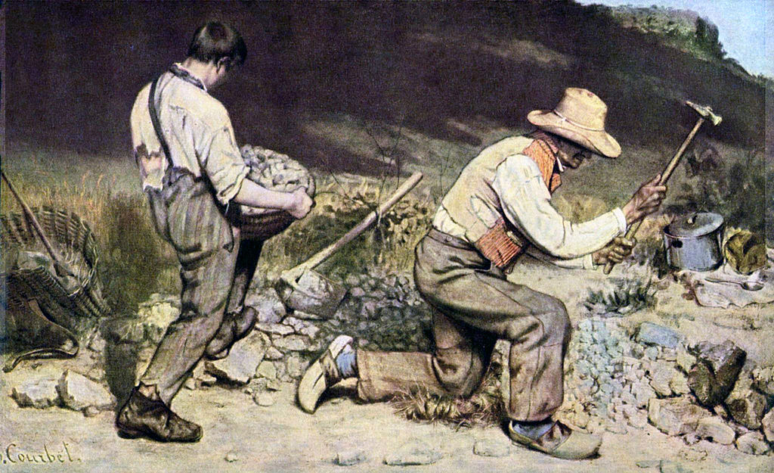
Gustave Courbet – The Stone Breakers

Slide 6
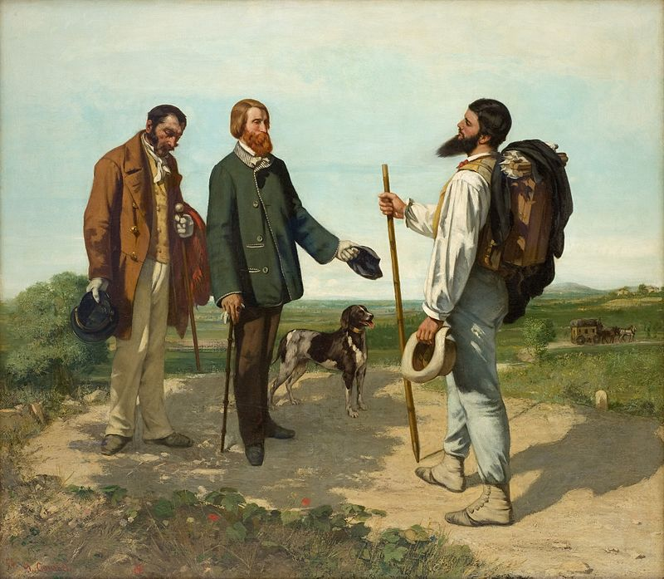
Gustave Courbet – Bonjour, Monsieur Courbet

Slide 7
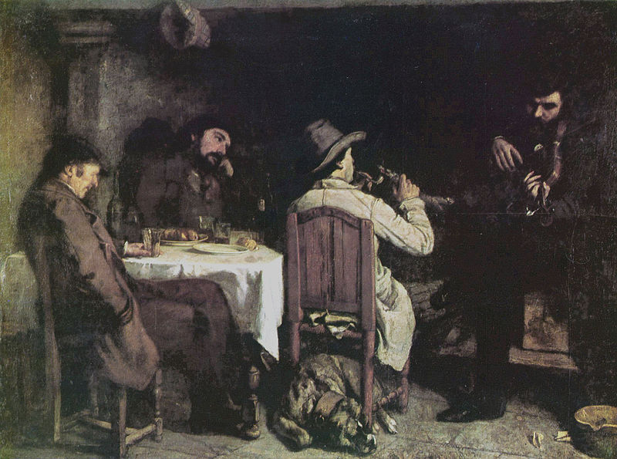
Gustave Courbet – After Dinner at Ornans

Slide 8
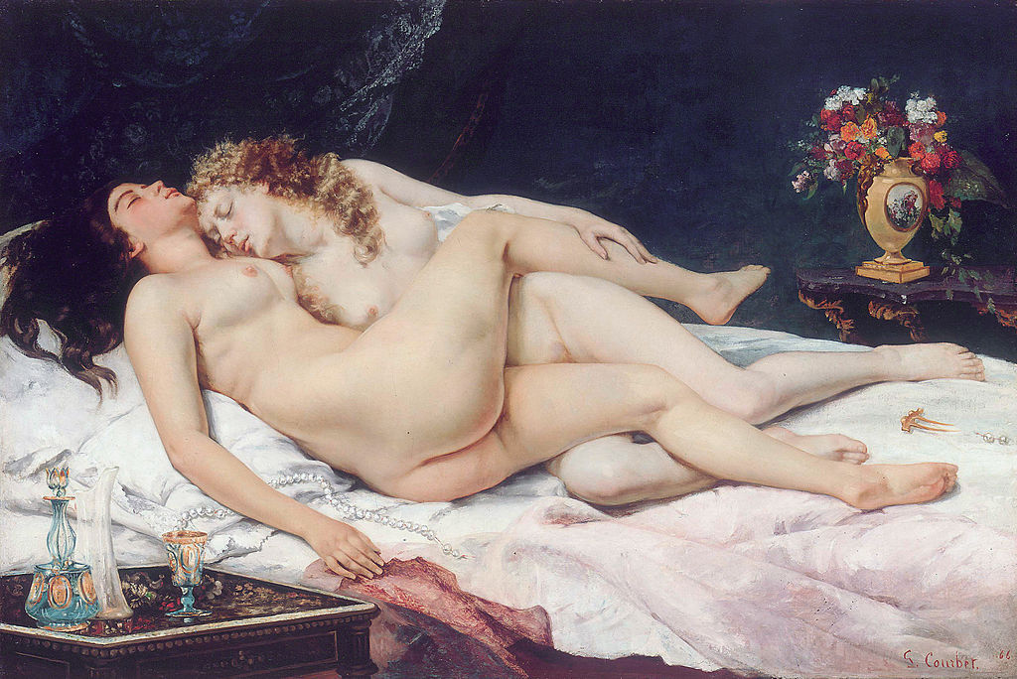
Gustave Courbet – Sleep

