Slide 1
Surrealism
Art movement

Slide 2
beginnings
Surrealism is a cultural movement that began in the early 1920s, and is best known for its visual artworks.
Surrealism developed out of the Dada activities during World War I and the most important center of the movement was Paris.
From the 1920s onward, the movement spread around the globe, eventually affecting the visual arts, literature, film, and music.

Slide 3
Basic characteristics
The aim was to "resolve the previously contradictory conditions of dream and reality into an absolute reality, a super-reality".
Artists painted unnerving, illogical scenes with photographic precision, created strange creatures from everyday objects and developed painting techniques that allowed the unconscious to express itself.
Surrealist works feature the element of surprise, unexpected juxtapositions and non sequitur.

Slide 4
Main Surrealists
Max Ernst,
Joan Miró,
Yves Tanguy,
Francis Picabia,
Salvador Dalí.

Slide 5
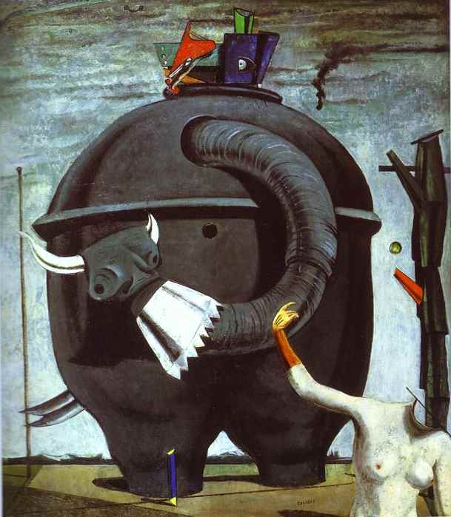
Max Ernst

Slide 6
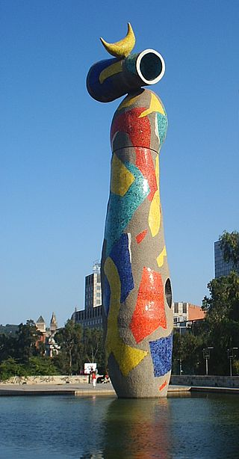
Joan Miró

Slide 7
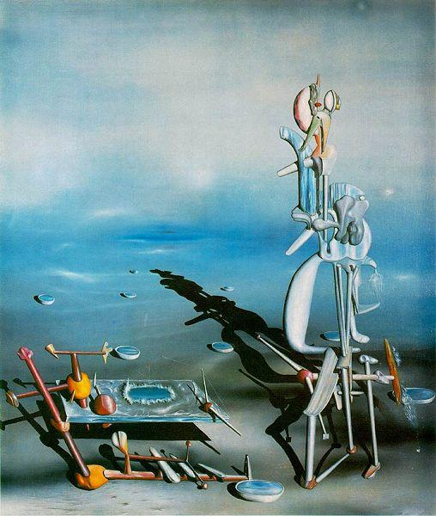
Yves Tanguy

Slide 8
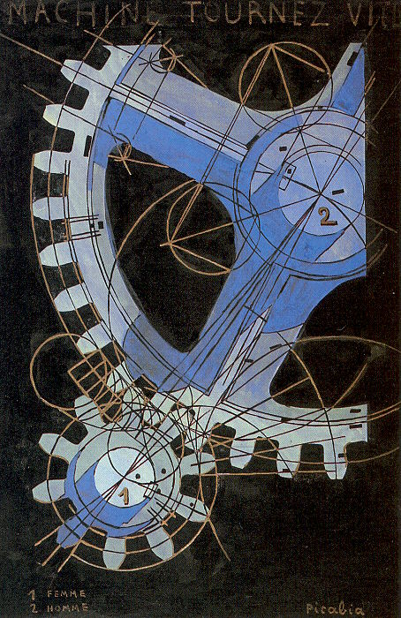
Francis Picabia

Slide 9
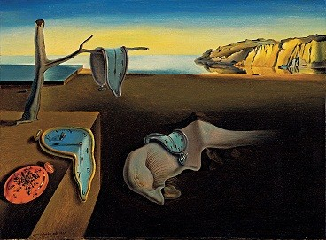
Salvador Dalí

