Slide 1
Gass Embolism

Slide 2
Air or Gas Embolism​
An air or gas Embolism appears in blood vessels. It is an air bubble which is trapped within the vessel that blocks the blood flow​
It can occur in either an artery or a vein. When it appears in an artery it travels to parts with narrower vessels, and it completely stop the blood flow. When it appears in a vein it causes difficulties with the respiratory system. ​

Slide 3
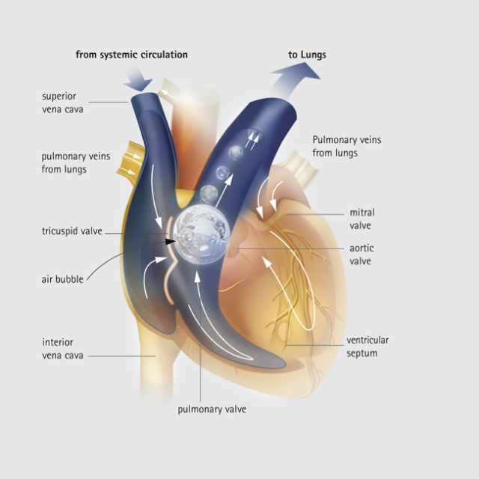

Slide 4
Possible effects
Embolism in the arteries to the brain – loss of consciousness and seizures​
Embolism in the coronary arteries (leading to the heart) - heart attack or irregular heartbeat​

Slide 5
Symptoms of an air embolism
Joint and mucsle pain
Low blood pressure
Irregular heartbeat
Breathlessness
Blurred vision
Chest pain
Anxiety

Slide 6
Treating air embolism
Immediate recompression
Lying in a hiperbaric chamber for several hours
Breathing a mixture of gasses and oxygen under pressure
The high pressure will restore the blood flow
The pressure forces the bubbles to dissolve in the blood flow

Slide 7
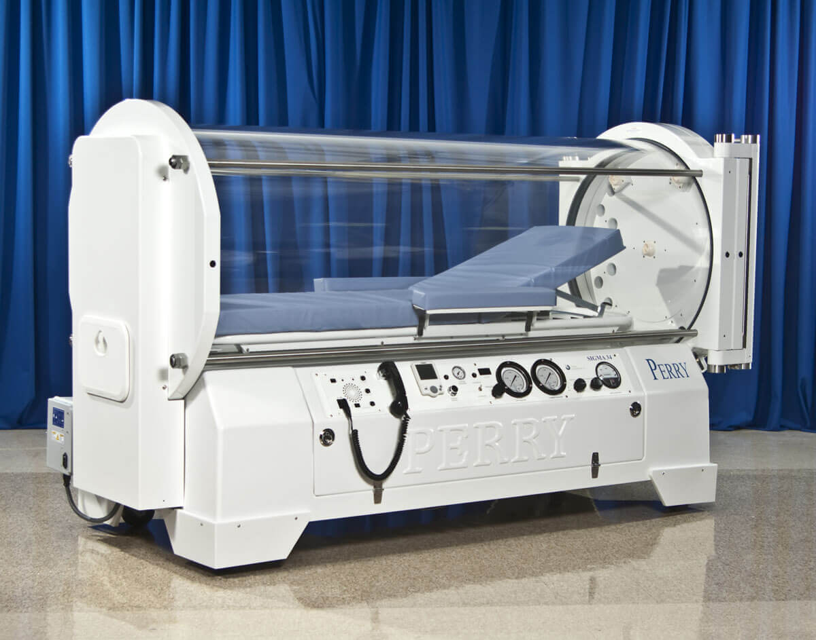
Hyperbaric chamber

Slide 8
Causes of embolism
Scuba diving
Injections (air was not properly removed)
During surgery and other medical proceduress

