Slide 1
Macedonia
Geography

Slide 2
Macedonia
Republic of Macedonia is a country in the Balkan peninsula in Southeast Europe.
Macedonia has borders with Kosovo to the northwest, Serbia to the north, Bulgaria to the east, Greece to the south, and Albania to the west.
Macedonia has 2.06 million inhabitants.
The majority of the residents are ethnic Macedonians, a South Slavic people. Albanians form a significant minority at around 25 percent, followed by Turks, Romani, Serbs, and others.

Slide 3
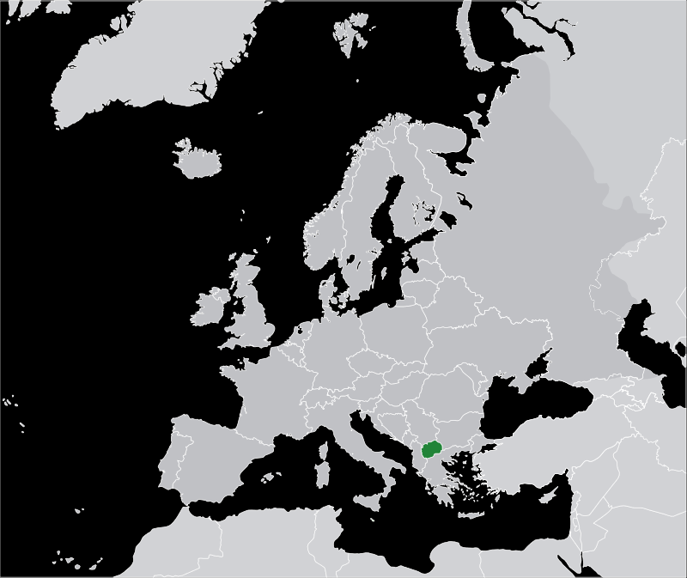

Slide 4
Symbols of Macedonia - flag

Slide 5
Symbols of Macedonia - Coat of arms

Slide 6
Hydrography
In the Republic of Macedonia there are 1,100 large sources of water. The rivers flow into three different basins: the Aegean, the Adriatic and the Black Sea.
The Aegean basin is the largest and the river Vardar is the largest river in this basin.
The river Black Drin forms the Adriatic basin. It receives water from Lakes Prespa and Ohrid.
Macedonia has around fifty ponds and three natural lakes, Lake Ohrid, Lake Prespa and Lake Dojran.

Slide 7
River Vardar

Slide 8
Lake Ohrid

Slide 9
Lake Prespa

Slide 10
Lake Dojran

Slide 11
National parks
Macedonia has has three national parks:
Mavrovo
Galičica
Pelister

Slide 12
Mavrovo National Park
This is the largest of the three national parks of the Republic of Macedonia.
It is located in the west of the country between Lake Mavrovo and the Albanian border.
In the boundaries of the Mavrovo National Park are included thirty seven settlements of four local regions (Mavrovo Valley, Gorna Reka, Mala Reka and Dolna Reka) .

Slide 13
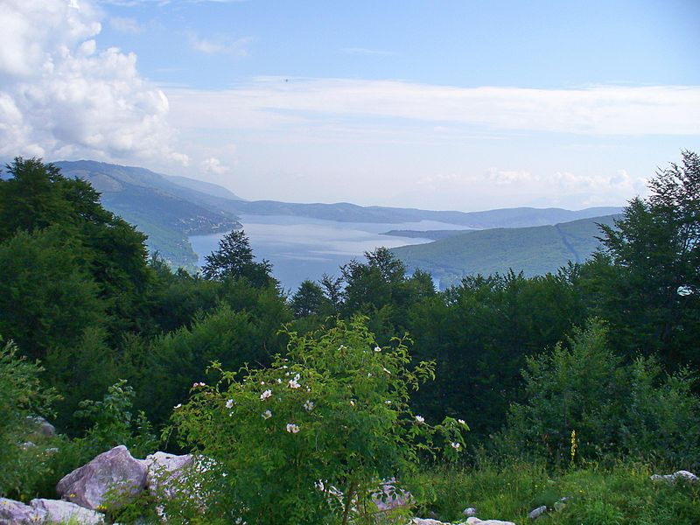

Slide 14
Bistra Mountain

Slide 15
Korab Mountain

Slide 16
Deshat Mountain

Slide 17
Radika River

Slide 18
Galičica National Park
Galičica National Park is on the Macedonian side of the mountain Galičica, situated between the two biggest lakes in the republic: Lake Ohrid and Lake Prespa.
It stretches over an area of 227 square kilometres.
The floral life in the Galičica National Park represents over 1000 species, of which a large number of relicts and endems have the final frontier of its range exactly on the mountain Galičica. There is characteristically presence of up to now 11 discovered local endems to be found exclusively on the slopes of Galičica and nowhere else.
both lakes and neighbouring mountains can be seen from the Galičica peaks.

Slide 19
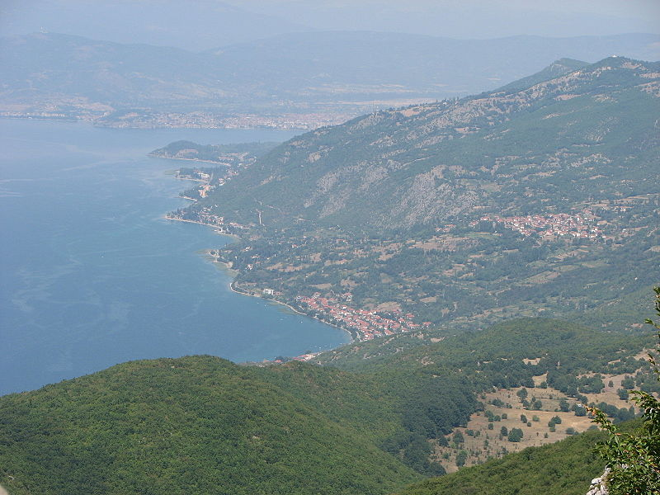

Slide 20
Pelister National Park
The park is located in the Baba Mountain massif in the Municipality of Bitola.
Among flora elements, the presence is especially significant of the five-needle pine molica, Pinus peuce - a unique species of Cenozoic age being present on only a few mountains in the Balkan Peninsula.
The beauty of the landscape is enhanced by the diverse wildlife: bears, roe deer, wolves, chamois, deer, wild boars, rabbits, several species of eagles, partridges, red-billed choughs, and the endemic Macedonian Pelagonia trout.

Slide 21
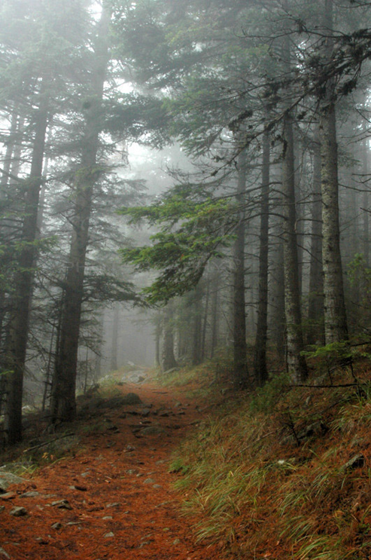

Slide 22
Greetings from the beautiful Macedonia

