Slide 1
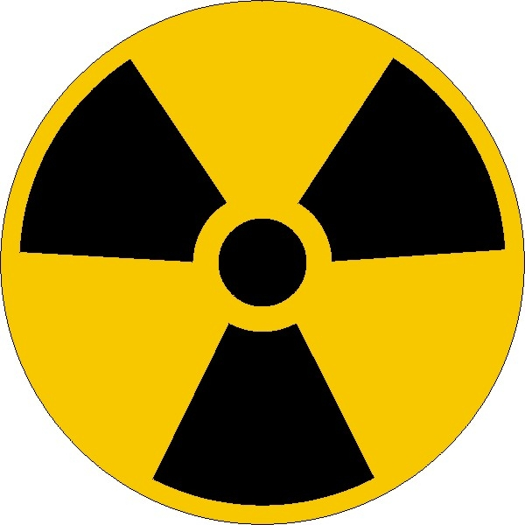
Absorbed dose of radiation and its biological influence

Slide 2
Ionizing radiation is being used more and more in technology, medicine, chemistry and military industry etc., and with that brings many advantages to humanity, but also new dangers – radioactive polution. The environment becomes polluted by radiation due to nuclear probes and possible disasters of the nuclear plants.

Slide 3
Dosimetry
In order to study the laws and methods of measurement of ionizing radiation a new branch of applied nuclear physics has been developed - dosimetry.
The devices that measure the ionizing radiation are called dosimeters.

Slide 4
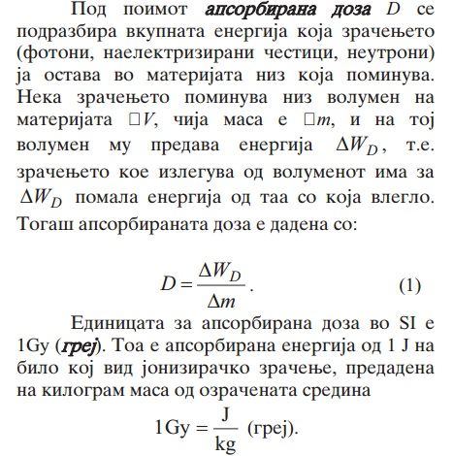
Dosimetric quantities and their units
In order to quantify the influence of radiation on matter, especially on live organisms, a new quantity is introduced: -absorbed dose
- Equivalent dose
The absorbed dose D is a quantity that represents the total energy of the radiation (photons, charged particles, neutrons) which is imparted on the matter through which it passes. If the radiation passes through volume V, with mass m, and to that volume gives energy W (the energy of the transmitted radiation is lowered by the same amount).
Then, the absorbed dose is:
The unit for absorbed dose in SI is 1 Gy (gray). It is the absorbed dose for ionizing radiation with energy 1 J per 1kg of mass:

Slide 5
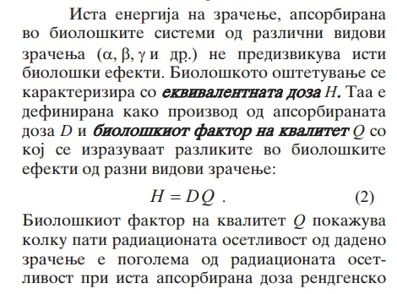
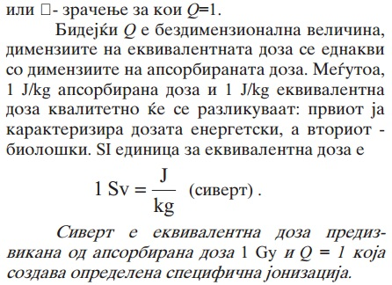
The same energy of radiation, absorbed by biological systems does not always cause the same effects. The biological damage is characterized by the equivalent dose H. It is defined as the product of the absorbed dose D and the biological factor of effectiveness Q, which describes the difference in biological effects.
Because Q is dimensionless, the dimensions of the absorbed dose and the equivalent dose are the same. But, 1 J/kg of absorbed dose and 1J/kg of equivalent dose are qualitatively different: the first describes the dose from an energetic aspect, and the second from a biological aspect. The SI unit of equivalent dose is:
(sievert)
The biological factor of effectiveness Q shows how many times the radiation sensitivity is greater than that of the gamma radiation, for which Q=1.
One sievert of equivalent dose is caused by one gray of absorbed dose and Q=1 caused by a specific ionization.

Slide 6
For example, an absorbed dose of 10 Gy caused by fast neutrons, with factor Q = 10, causes equivalent dose of 100 Sv. That means that the neutrons cause 10 times more damage than the gamma radiation with Q = 1. Even though the absorbed energy is the same in both cases, the equivalent dose caused by the neutron radiation is greater and causes more tissue damage. For alpha particles, heavy nuclei and fission fragments, Q = 20.

Slide 7
Biological changes
The biological changes which are the result of radiation are in first order due to the ionizing properties. The formation of ions and the creation of the reactive free radicals is the cause of transformations and creation of chemical products.

Slide 8
Under the influence of radiation, the water molecule dissociates, forming reactive free radicals. These free radicals react with other molecules in the biological system, and thus new types of molecules are obtained. The radicals in an aqueous solution react with organic molecules by taking away from them the H atoms, or even larger parts of the molecule (the rest of the molecule is called organic radical). This is done by breaking apart the molecular bonds. This behaviour of these organic radicals is especially important for the biological effects, because they react with other radicals or molecular oxygen, with which new types of molecules are obtained.

Slide 9
Consequences from the radiation
By its nature, radiation is harmful to human organisms. Even in small doses, the radiation can induce changes, which can lead to genetic changes with time, or even the development of cancer. In high doses, radiation destroys cells, damages the organs and can cause death. Of course, the damages caused by high doses of radiation are visible only after a few hours, but to develop cancer a lot more time is required. Hereditary deformations and illnesses caused by genetic damage due to radiation are only formed in the generations that follow.
Genetic consequences of radiation can be classified as: chromosomal aberrations and genetic mutations.
Chromosomal aberrations. The radiation creates chromosomal aberrations by tearing the chromosome.
Mutations. Radiation can cause mutation in two ways: by causing chemical changes in the DNA chain itself, or by causing tears between parts of the DNA chain.
Acute effects are best studied in mammals radiated by x-rays or gamma-rays. When a mature organism is exposed to radiation, a series of specific changes (syndromes) occur in the tissues and organs.

Slide 10
Doses greater than 100 Gy damage the central nervous system. The illness manifests itself through respiratory difficulties, loss of coordination, loss of consciousness etc. The doses from 9-100 Gy are also lethal. Death occurs 3-5 days after the radiation has taken place, because of injuries in the gastrointestinal system, loss of appetite, vomiting, diarrhea, depression. Doses from 3-9 Gy are sublethal and cause characteristic changes in the blood cells and hematopoietic organs which appear 10-15 days after the radiation, followed by malaise, bleeding, shaking, drop of leukocytes.
The total acute radiation injury is a result of the effect of radiation on multiple tissues and organs. This joint effect is called acute radiation syndrome. Whether the symptom will be lethal or not, depends on the individual radiosensitivity of the organism.

Slide 11
Delayed effects. In organisms that recovered from the acute radiation injuries, as well as the continuous exposure to radiation, pathological changes in the tissues and organs can develop over time.
The cancerogenic effect caused by ionizing radiation has been known since the first days of radiobiology, and has later been confirmed by many examples in people and experimental animals. The conclusion is that radiation can cause various types of cancer.

Slide 12
Because of the dependence of harmful radiation on the applied dose of ionizing radiation, there are very strict regulations in place with which a so called maximum permissible dose is set per year, month, week, hour. In fact, those are limiting doses for which the biological effects of the radiation can be measured. For professionals working with radiation, the maximum permissible dose per year is 50 mSv (for a week with 40 working hours). For non-professional exposure the annual dose is 1 mSv. With such low doses a small "radiation risk" is established meaning there is small probability for a person to suffer from the ionizing radiation.

